Slide 1
DRR-Pathways Project
An Urban Exposure Model for the Lower Mainland
Presenters: Philip LeSueur, M.Sc., P.Eng., P.Geo. - Natural Resources Canada Jeff Clark, B.Sc., A.D.Tech. GIS - Spatial Vision Group

Slide 2
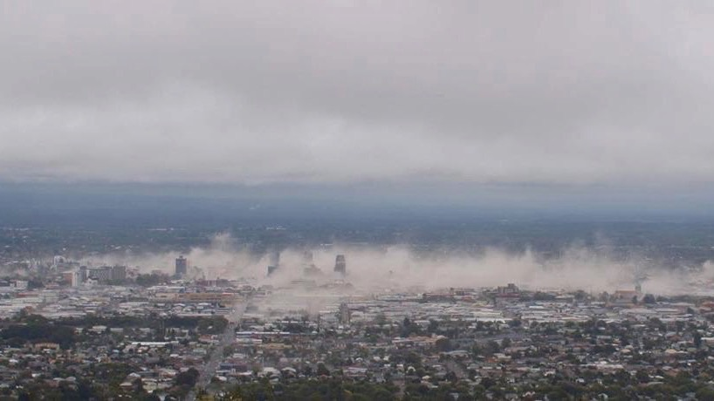
DRR-Pathways - Functional Recovery Planning
Baseline Conditions
Service resilience gap
Service Capacity
Ideal restoration rate
Likely restoration rate
Time
t_{o}
days
months
t₁
years

Slide 3
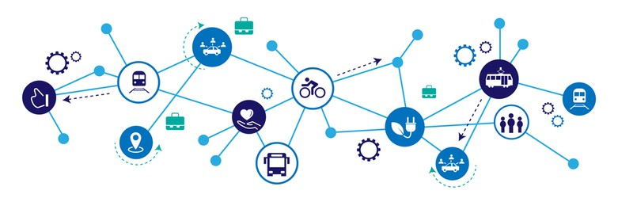

Slide 4
Components of an Urban Exposure Model to Support Systemic Risk Modeling in the Lower Mainland Region
Baseline Conditions
Building Systems
residential structures that provide shelter — and the full spectrum of commercial, industrial and civic facilities that support business functions across all sectors
Service Capacity
Business Systems
people, facilities, goods, services — and the functional ‘upstream’ and ‘downstream’ interdependencies that are required to support all aspects of disaster response and recovery
Water & Wastewater Systems
potable water supply and related treatment-transmission and distribution sub-systems;
wastewater collection and related conveyance-treatment-disposal subsystems
Energy & Communication Systems
power plants and related transmission-distribution sub-systems for electricity, oil and natural gas;
technical facilities and related landline-satellite and wireless transmission sub-systems
Transportation Systems
highways, roads, railways and associated bridges-tunnels connections;
mass transit, marine and airport facilities and related sub-systems
Time
t_{o}
t₁
days
months
years

Slide 5
Development of Provincial Critical Infrastructure Asset Database to Support National Critical Infrastructure Model (NCIM)
Spatial Vision Group contribution (2019):
Geospatial data inventory of BC’s critical infrastructure.
CI sectors in scope:
Energy and Utilities | Information and Communications Technology
Finance | Health Care
Food | Water
Transportation | Safety
Government | Manufacturing
Notes:
This data compilation project was an important predecessor to the DDR work as it identified extensive data gaps and issues at the provincial, regional and municipal scales. Public domain data was sourced for ten CI sectors which prioritized by DND and UVic research teams for further modeling.

Slide 6
Development of Comprehensive Regional Building Inventory for the Greater Metro Vancouver Region
Spatial Vision Group contribution (2020):
Fully-attributed building stock for residential and commercial parcels within Metro Vancouver.
Building layers derived from a combination of 14 existing and new data sources (incl. assessment and location data from BC Assessment).
430k residential / 25k commercial buildings.
Key attributes link to NRCan’s ‘Municipal Building layer’ (133k buildings) and North American industry codes (NAICS).
Provides support for generation of multi-hazard model at building level.
NRCan contribution (2020):
Attribution of building construction type using machine learning.
Replacement value estimation.
Building population estimation (day-time, night-time, in-transit).
Notes:
NRCan contribution (as I understand): machine learning to attribute construction types; modelling of replacement values (structure, building, contents), modelling of building populations (night-time, day-time, transit)

Slide 7
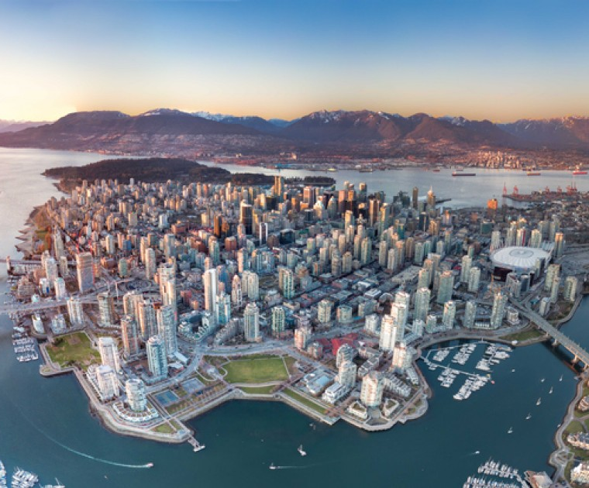
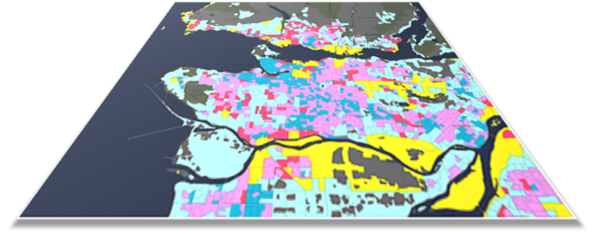
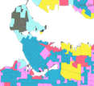
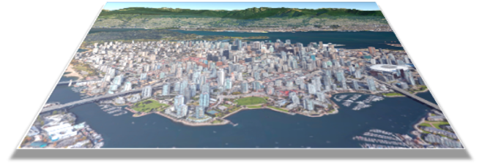
Building Inventory Attribute Summary
Landuse
Land Use
Residential low-, medium-, high-density; Commercial-Industrial; Mixed Use; Rural
Builiding Attributes
Building Location; Occupancy; Construction Type; Age; Number of Stories; Finished Floor Area
Population Dynamics
Day-time, Night-time, In-Transit Occupants
Building Replacement Value
Structural and Non-Structural Components; Contents; Retrofit Costs

Slide 8
LEGEND
Critical Infrastructure
Hospital
Essential Facility
Bridge
Transportation Systems
Critical Infrastructure – transportation systems & essential facilities

Slide 9
Critical Infrastructure
Energy Systems
Water/Wastewater Systems
Critical Infrastructure – utilities

Slide 10
LEGEND
Buildings (460,000)
Industrial
Commercial
Residential-HD
Residential-LD
Buildings

Slide 11
Outcomes and Impact
Lower Mainland Exposure Model
Baseline input for seismic risk modelling and multi-hazard threat assessment (NRCan).
Baseline input for critical infrastructure failure and service disruption modelling (UVic and DRDC).
Used to support dynamic risk modelling of Metro Vancouver (UBC).
Methods have been adapted to develop the national exposure model.
Used for flood risk modelling (Fraser Basin Council)
Detailed understanding of the current infrastructure across the Lower Mainland.

Slide 12
Thanks
Philip LeSueur, M.Sc., P.Eng., P.Geo. Research Scientist
Natural Resources Canada
philip.lesueur@canada.ca
Jeff Clark, B.Sc., A.D.Tech. GIS Partner
Spatial Vision Group jeff.clark@spatialvisiongroup.com

