Slide 1
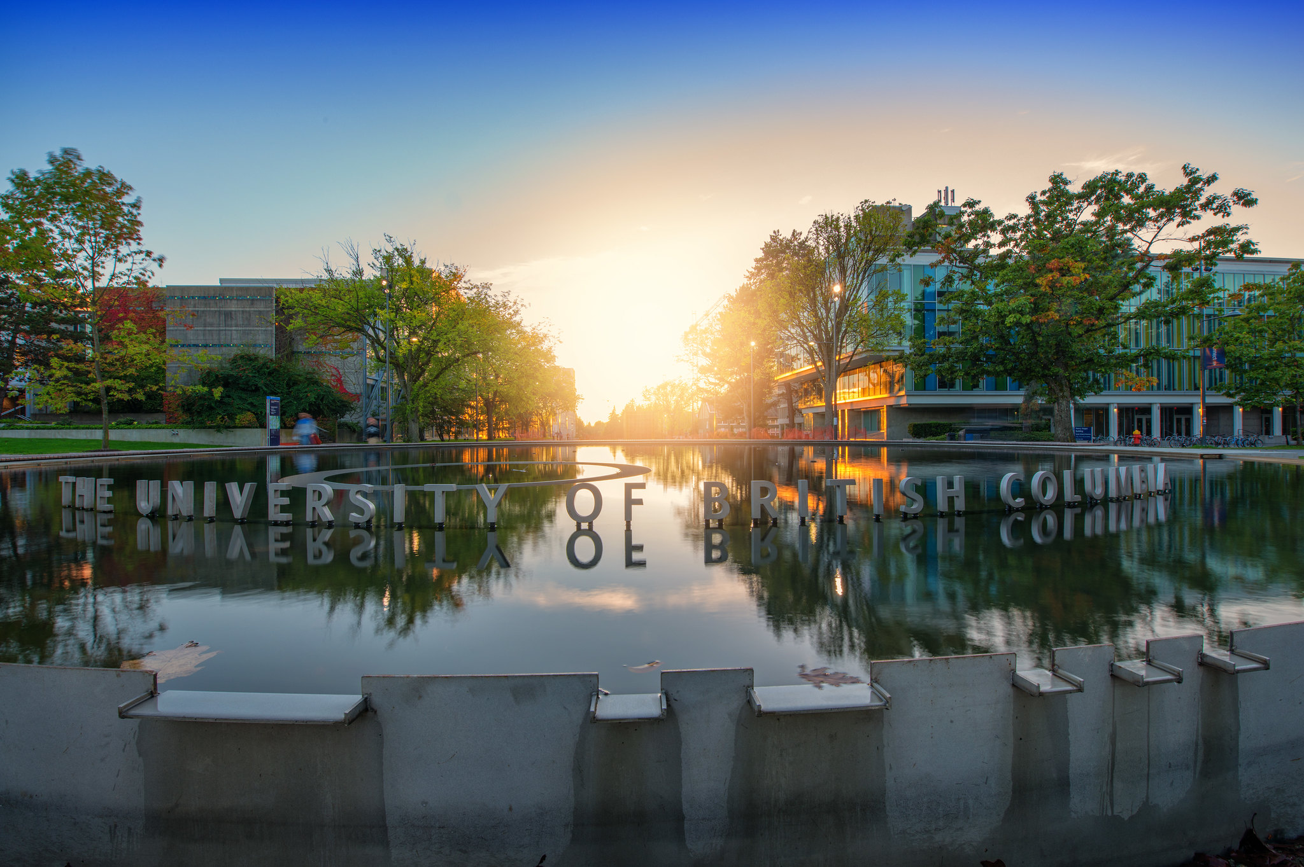

DRR Pathways: Risk Dynamics Modelling in Metro Vancouver
Exploring the changing seismic risk across Metro Vancouver over time related to urban growth and development
Ryan P. Reynolds, Postdoctoral Research Fellow
ryan.reynolds@ubc.ca
Notes:
Thanks …
Today I’m going to talk about the first of three projects our team at UBC contributed to the pathways project, our work on Risk Dynamics Modelling.
Completed in December 2019

Slide 2
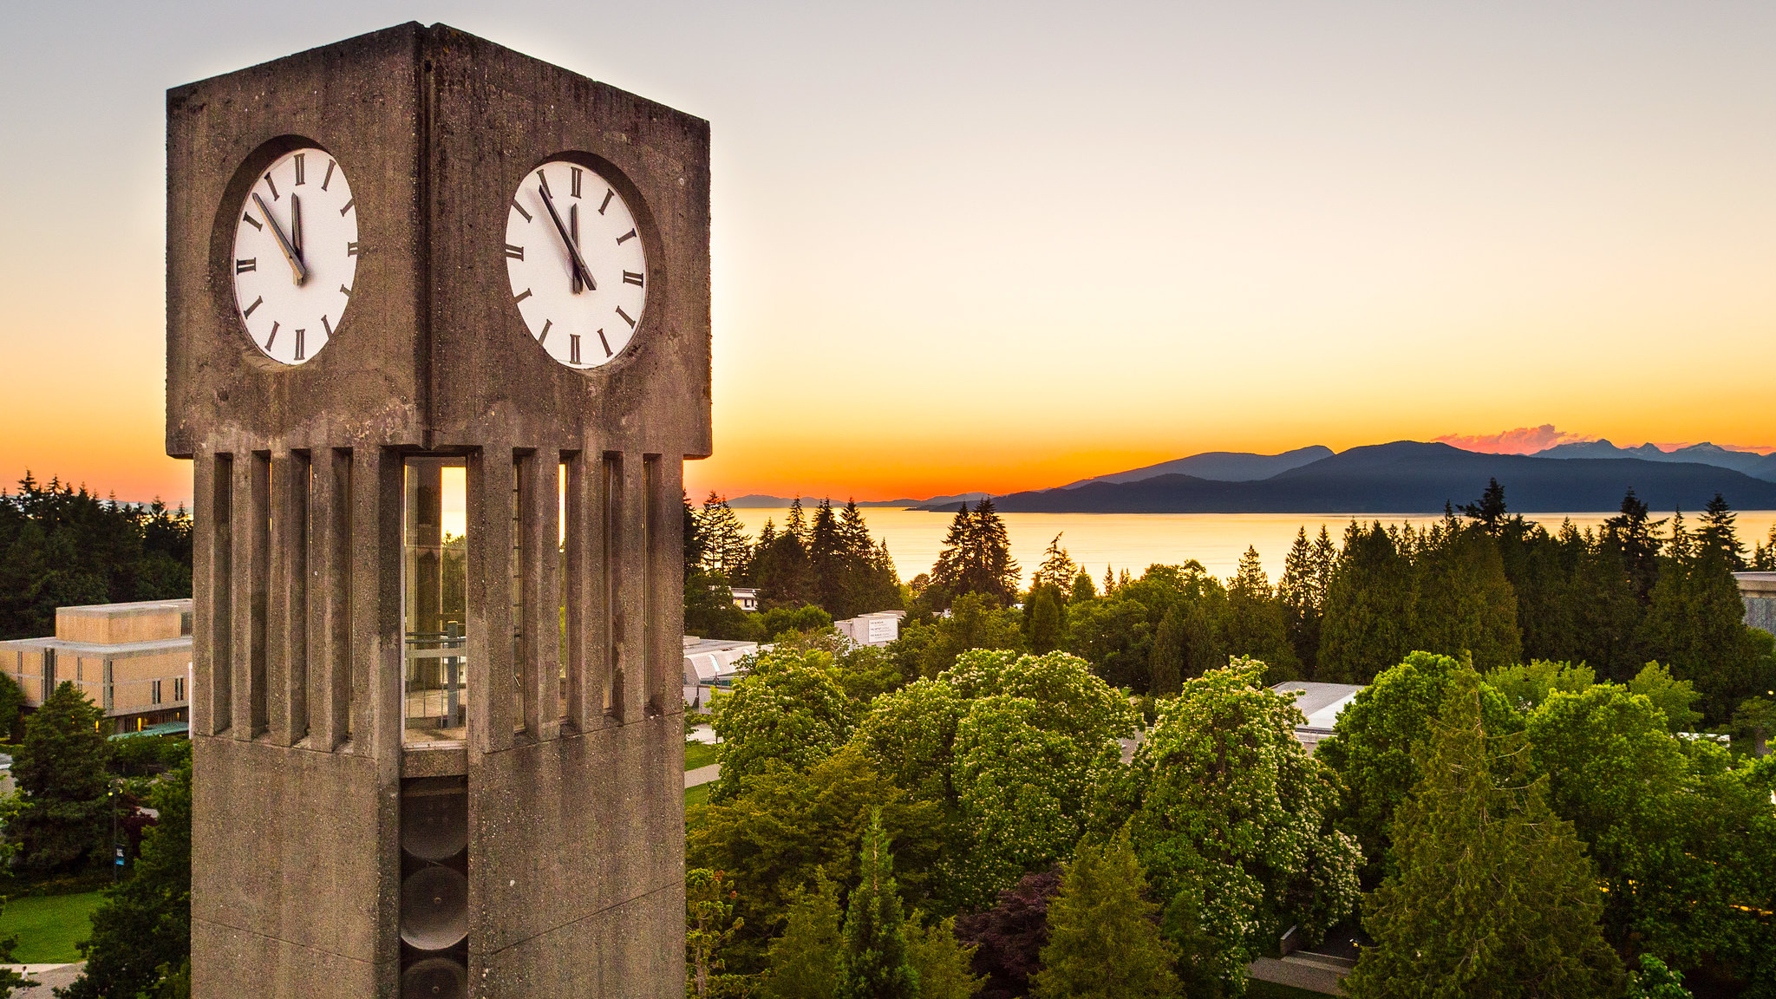
Risk Dynamics - Our Changing Risk Landscape
Risk dynamics pertains to how the potential for disaster losses in an urban area may change over decadal timeframes related to factors such as population growth, land-use changes, new construction, building code improvements, etc.
Loss model results for today’s conditions may present an inaccurate and even misleading portrayal of potential future losses.
Notes:
Risk dynamics pertains to how the potential for disaster losses in an urban area may change over decadal timeframes. Disaster risk will transform over time in relation to factors such as population growth, land use change, new construction, building code improvements, etc. Over time, overall risk may increase or decrease, some types of losses may become more prominent, and the locations of risk “hotspots” may shift. Efforts to anticipate future risk must consider not only shifts in numerous individual factors but also their interactions.
Cities are continually changing. Similar natural hazard events can cause different degrees and patterns of loss if they strike at different moments in a city’s history. Loss model results for today’s conditions may present an inaccurate and even misleading portrayal of potential losses in future years. If disaster mitigation policies and plans are made without accounting for future risk increases, for example, they may be unduly conservative and skewed in the direction of current-day conditions. Anticipating future risk trends and patterns can help to identify and better characterize the effectiveness of different risk reduction strategies.

Slide 3
Future Earthquake Impacts in Metro Vancouver
Our team partnered with Metro Vancouver and Natural Resources Canada (NRCan) to better understand how the way our neighbourhoods change over time is likely to affect earthquake impacts in the future.
To do this, we needed to explore how neighbourhoods in the region have changed over the past decade to help us understand how they are likely to change in the decades ahead. Once we understand these changes, we can use today’s earthquake impact assessments to project how a future earthquake might impact a given neighbourhood.
For our work, we used Metro Vancouver’s 2035 growth projections and a M7.3 Georgia Strait earthquake scenario produced by NRCan.
Notes:
Our team partnered with Metro Vancouver and Natural Resources Canada (NRCan) to better understand how the way our neighbourhoods change over time is likely to affect earthquake impacts in the future.
To do this, we needed to explore how neighbourhoods in the region have changed over the past decade to help us understand how they are likely to change in the decades ahead. Once we understand these changes, we can use today’s earthquake impact assessments to project how a future earthquake might impact a given neighbourhood.
For our work, we used Metro Vancouver’s 2035 growth projections and a M7.3 Georgia Strait earthquake scenario produced by NRCan.

Slide 4
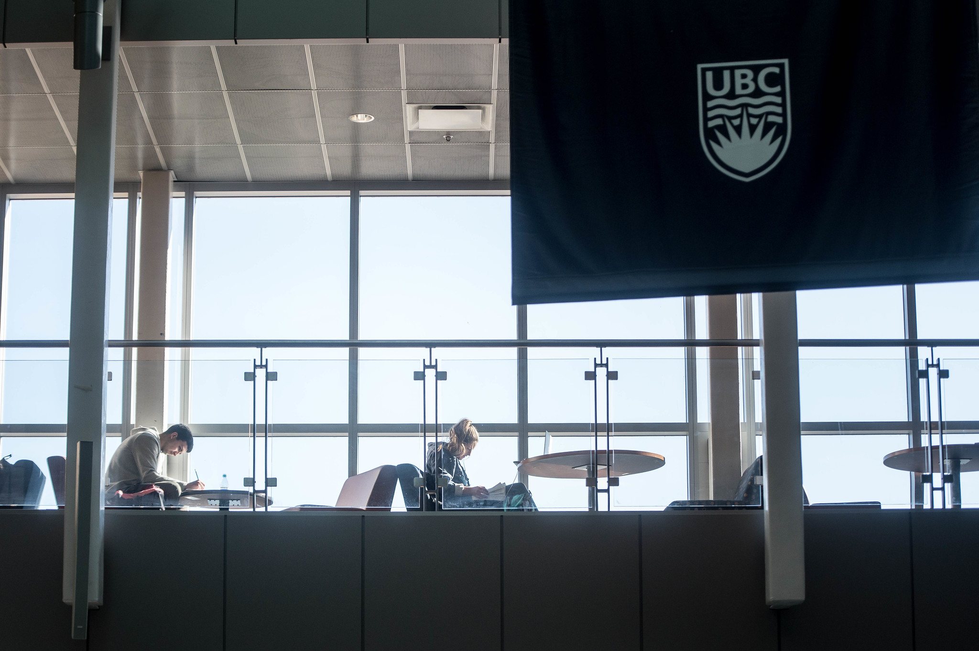
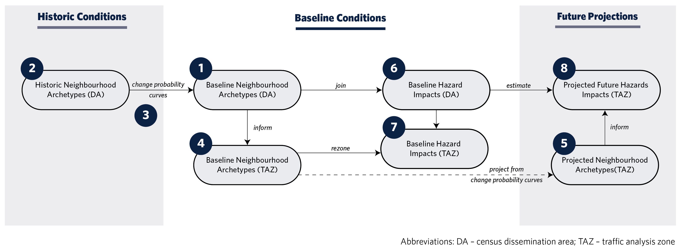
Risk Dynamics Methodology
Establish baseline neighbourhood archetypes
Establish historic neighbourhood archetypes
Calculate change probability curves
Establish archetypes to baseline traffic analysis zones
Project future archetypes based on change probability curves
Baseline NRCan earthquake impact assessment
Establish earthquake impacts for traffic analysis zones
Project future earthquake impacts for future TAZ informed by baseline hazard impacts
Notes:
Our team developed an eight-step process to explore how future hazard impacts might impact the Metro region in 2035.
Establish baseline neighbourhood archetypes
Establish historic neighbourhood archetypes
Calculate change probability curves
Establish archetypes to baseline traffic analysis zones
Project future archetypes based on change probability curves
Baseline NRCan earthquake impact assessment
Establish earthquake impacts for traffic analysis zones
Project future earthquake impacts for future TAZ informed by baseline hazard impacts

Slide 5
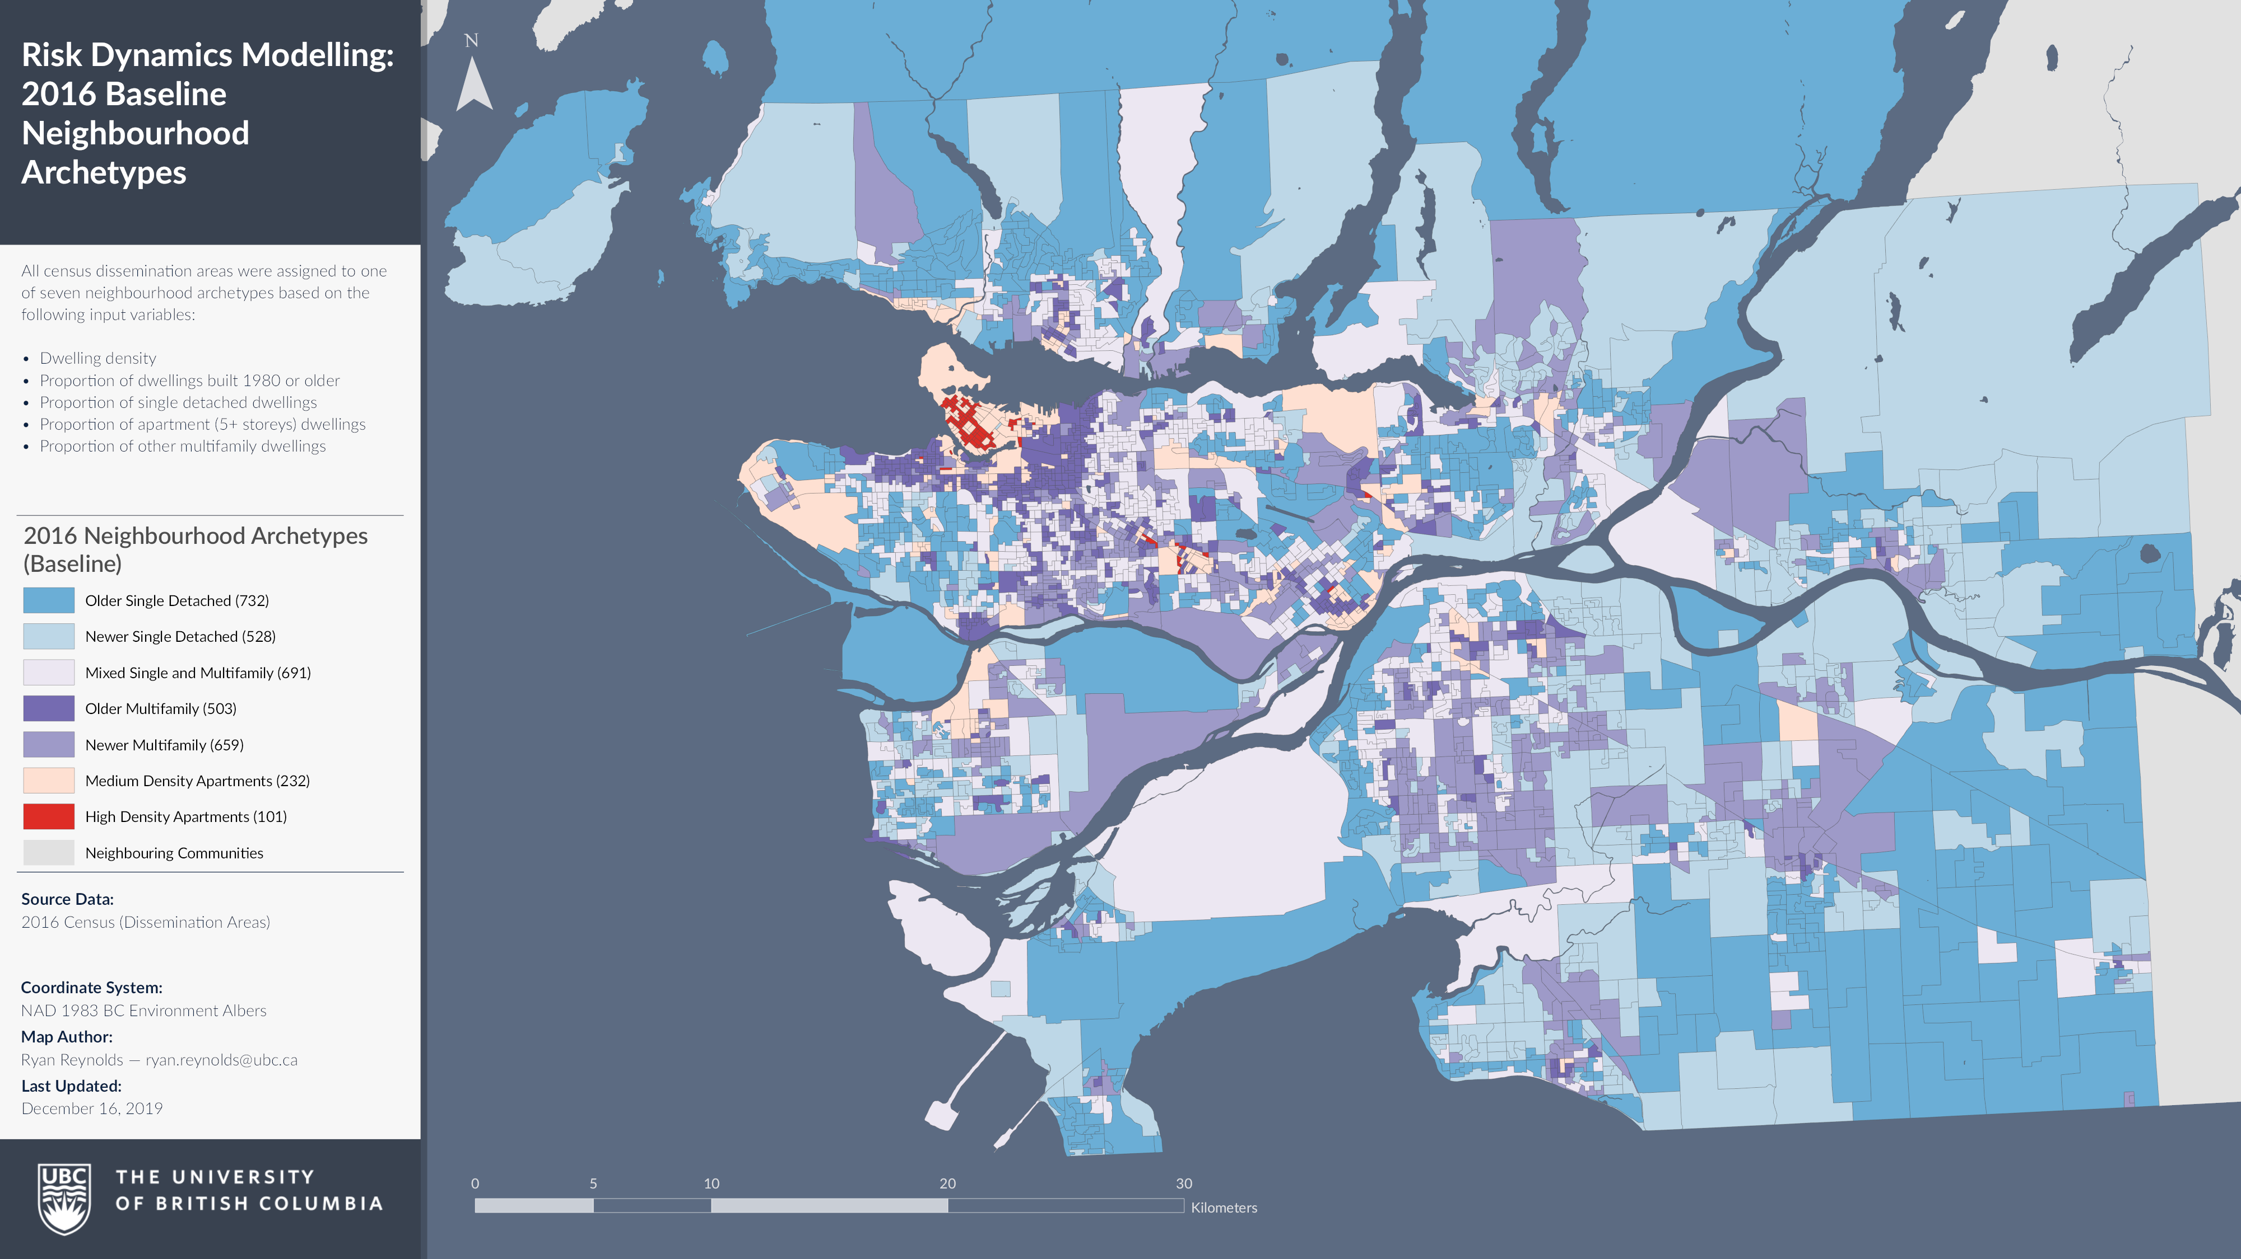
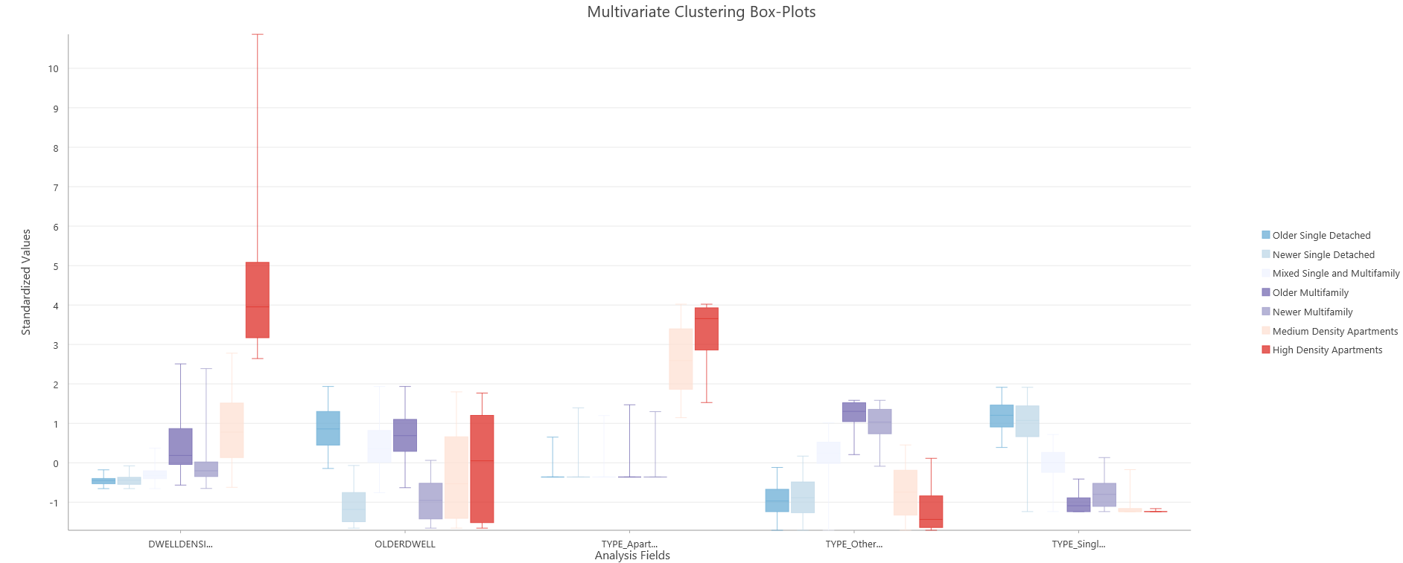
Figure: Box plots for individual parameters within each cluster
Notes:
Established baseline neighbourhood archetypes from 2016 census
This work relied on understanding dwelling density,
the proportion of older dwellings,
The proportion of single-detached, multifamily, and apartment dwellings.

Slide 7
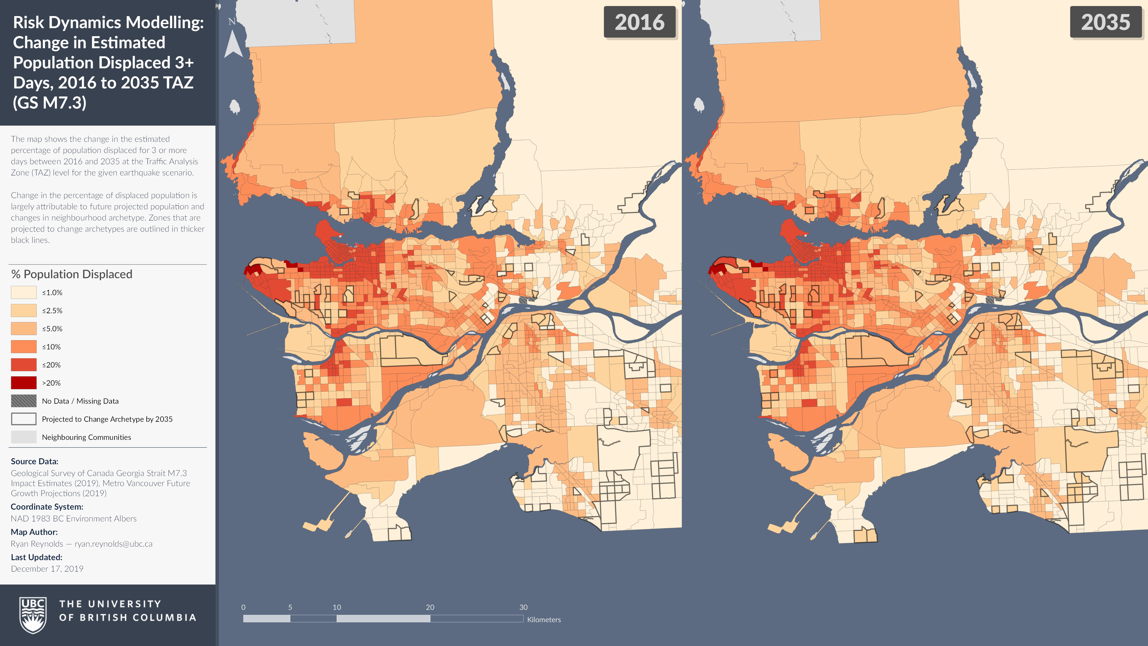
 | 2016 | 2035 | Change
Total Population¹ | 2,580,000 | 3,370,000 | 787,000
Displaced Population² | 133,000 | 1176,000 | 43,000
% Displaced | 5.15% | 5.22%
¹ 25 of 32 Metro Vancouver Municipalities; ² M7.3 Georgia Strait Earthquake

