Slide 1
DRR Pathways: Neighbourhood Social Vulnerability in the City of Vancouver
Assessment of neighbourhood-level socio-economic vulnerability indicators to support the City’s seismic retrofit program
Ryan P. Reynolds, Postdoctoral Research Fellow ryan.reynolds@ubc.ca
Notes:
Completed in September 2019

Slide 2
Our Role in Pathways
Our team, led by Dr. Stephanie Chang, is made up of researchers and graduate students with backgrounds in engineering, planning, geospatial modelling, emergency preparedness, and risk communication.
Our role as social scientists, is to explore hazards risk through the lens of communities, neighbourhoods, and households, incorporating both physical and social impacts at each scale. This work builds on top of the hazard risk modelling scenarios and physical impact assessments completed by our other Pathways partners.
Combining the physical and social aspects of risk helps us to identify those neighbourhoods that are most susceptible to disruption following a disaster, and work with planners and emergency managers to implement strategies that help promote community hazards resilience.

Slide 3
Supporting Vancouver’s Seismic Retrofit Program
Our team partnered with the City of Vancouver, Natural Resources Canada, Sage on Earth and others to better understand the spatial distribution of socially vulnerable populations within Vancouver as part of the City’s seismic retrofit program.
The project aimed to help policymakers determine which neighbourhoods are most vulnerable to disaster impacts and link this information to the physical impacts described by NRCan’s earthquake scenarios.
Our end goal was to help reduce social vulnerability and increase community earthquake resilience.

Slide 4
Social Vulnerability
Social vulnerability refers to a combination of factors that determine the susceptibility of a person, group, or community to the effects of a disaster due to their physical, social, or economic traits. Vulnerable groups are often more deeply impacted by disaster events and may take longer to recover following such an event.
Like physical damage, the social impacts of disasters are not distributed evenly across space, through time, or within affected populations. Often, the groups with the least capacity to respond experience the most substantial impacts.
Notes:
Social vulnerability refers to a combination of factors that determine the susceptibility of a person, group or community to the effects of a disaster due to their physical, social, or economic traits.
Vulnerable groups are often more deeply impacted by disaster events and may take longer to recover following such an event.
Common metrics used to assess community social vulnerability include:
Age, Gender, Sexual identity, Health, Disability, Housing & shelter, Tenure, Income, Immigration status, and Employment status
Like physical damage, the social impacts of disasters are not distributed evenly across space, through time, or within affected populations. Often, the groups with the least capacity to respond experience the most substantial impacts.

Slide 5
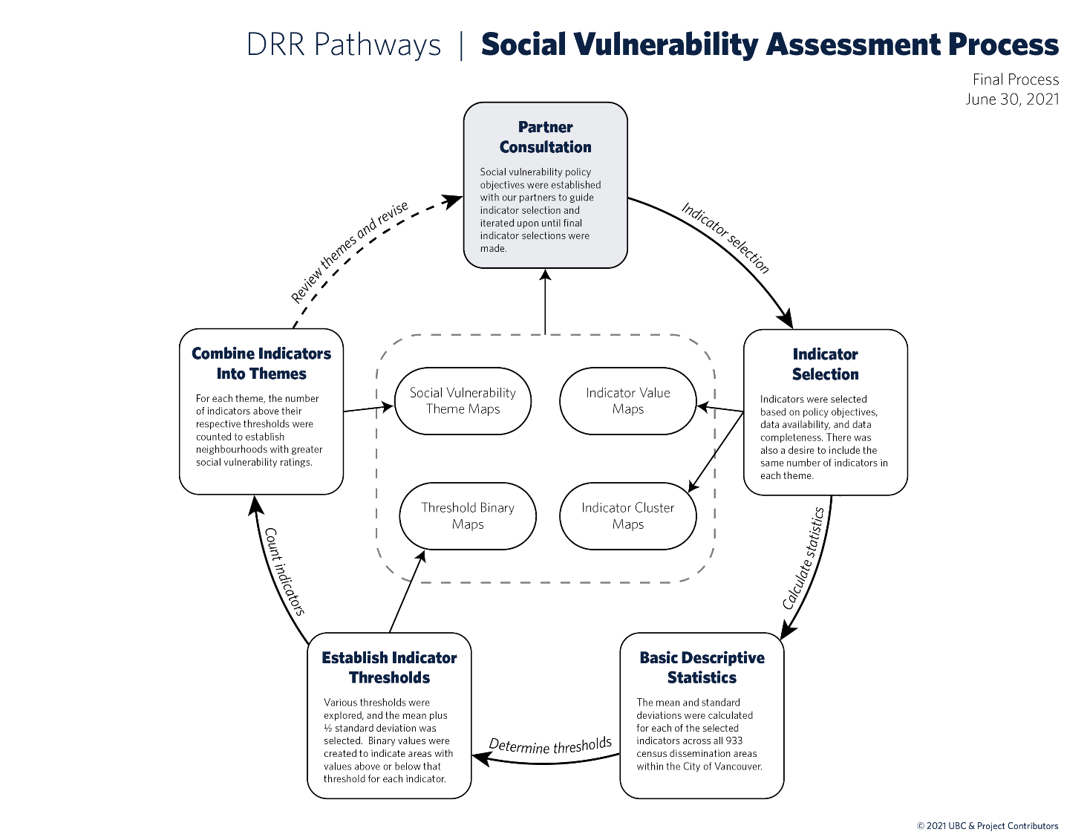
Methodology
We iterated through a six-step process to measure and summarize information about social vulnerability in consultation with our project partners.
This iterative process allowed us to isolate the social vulnerability themes that best addressed the City’s policy objectives for the seismic retrofit project, identify those measures of vulnerability best fit to those themes, and establish a methodology for combining indicators into a meaningful index.

Slide 6
Social Vulnerability Themes
Reduced Financial Capacity
Neighbourhoods with residents with lower financial ability to respond or recover following a disaster
Greater Social Services Dependence
Neighbourhoods with residents that may have a greater need for and dependence upon social services
Housing and Shelter Challenges
Neighbourhoods with residents that may face difficulties acquiring emergency shelter or permanent housing
Notes:
Together with our partners, we identified three social vulnerability themes which built upon a set of 14 socio-economic indicators derived from the 2016 census.
These themes are:

Slide 7
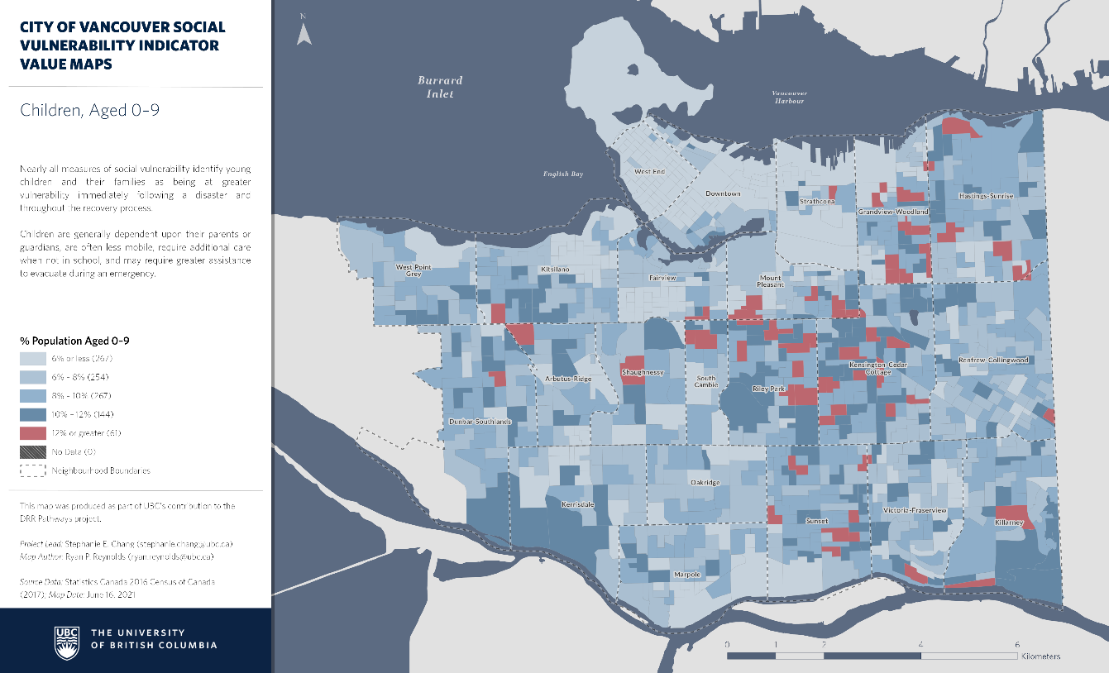
Thresholding Indicators
For each indicator, a threshold was established to identify neighbourhoods with above average values, representing higher vulnerability.
Several thresholding approaches were explored, but the approach that best fit our needs was to set the thresholds at the level of half a standard deviation above the mean for each indicator:
$$t=\overline{x}+\frac{σ}{2}$$
Binary variables were created to indicate those neighbourhoods that were above these threshold values.
Notes:
Areas shown in darker blue and red are experiencing above average levels of vulnerability for this indicator

Slide 8
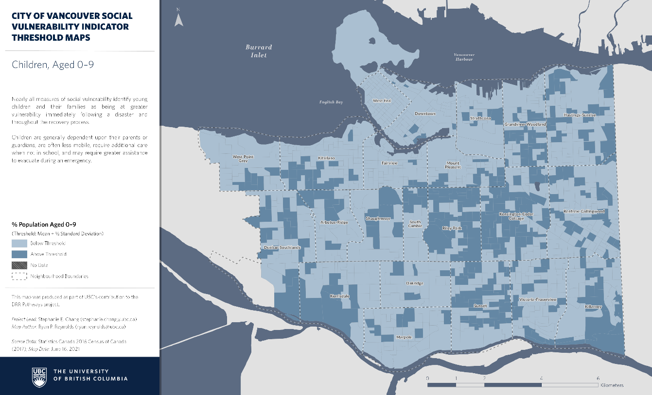
Thresholding Indicators

Slide 9
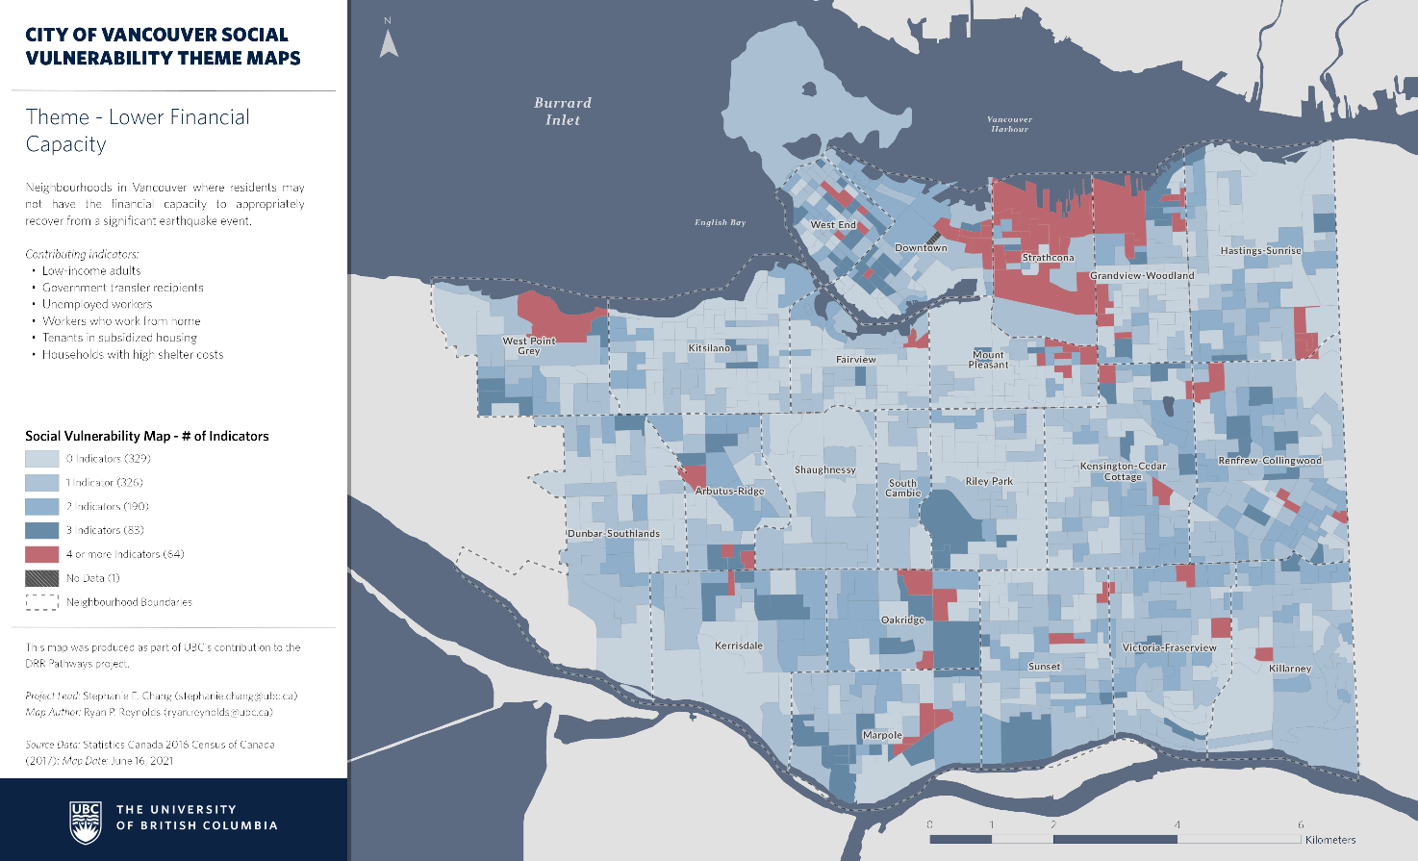
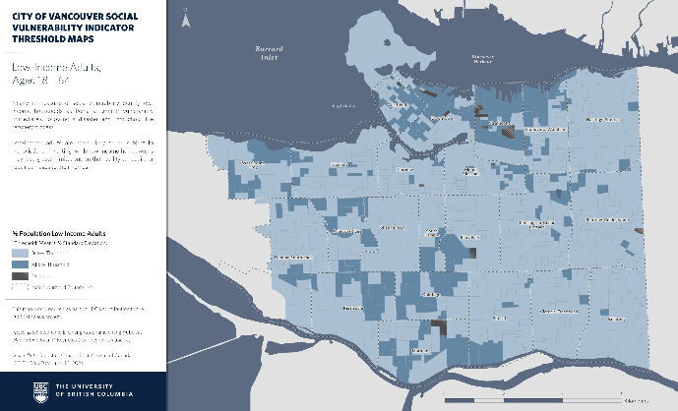
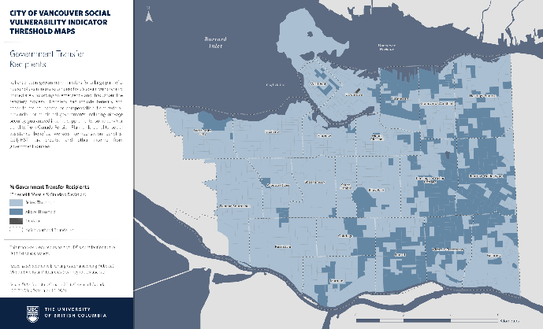
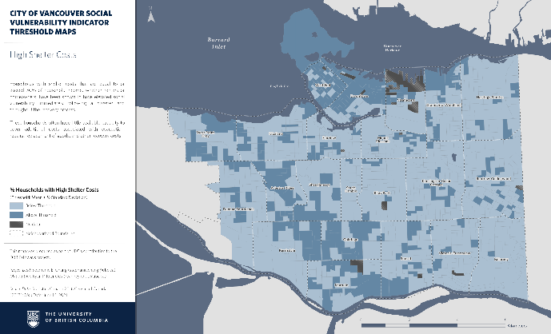
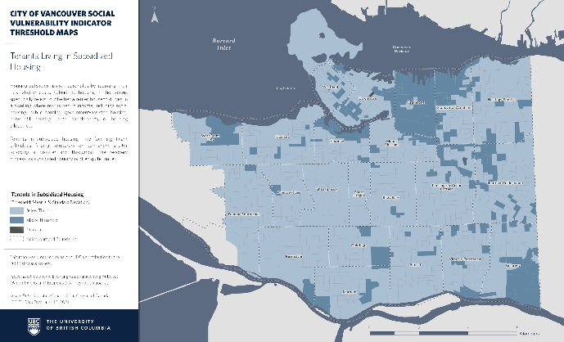
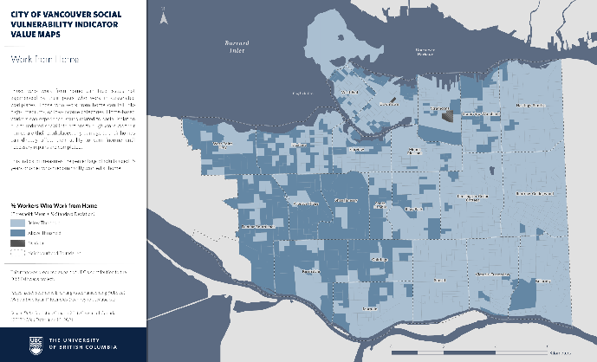
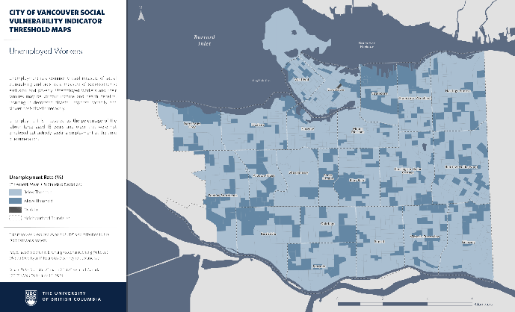
Theme Creation

Slide 10
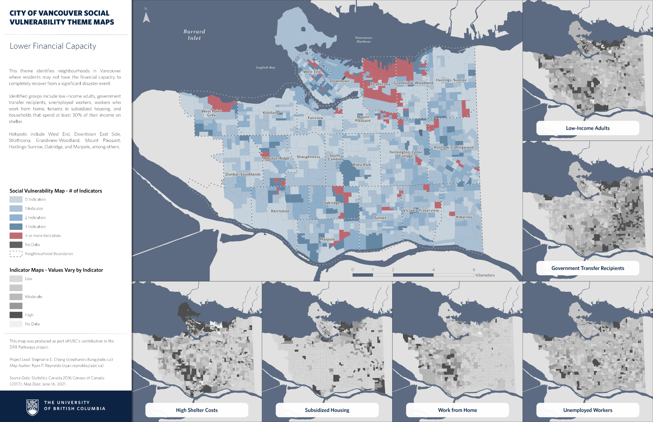
Theme 1: Lower Financial Capacity
This theme identifies neighbourhoods in Vancouver where residents may not have the financial capacity to completely recover from a significant disaster event.
Identified groups include low-income adults, government transfer recipients, unemployed workers, workers who work from home, tenants in subsidized housing, and households that spend at least 30% of their income on shelter.
Hotspots include the West End, Downtown East Side, Strathcona, Grandview-Woodland, Mount Pleasant, Hastings-Sunrise, Oakridge, and Marpole, among others.
Notes:
Here you see the results of our first theme, lower financial capacity. Areas shown in darker blue and red are experiencing above average levels of vulnerability for this theme. The theme integrates information from six indicators:
Low income adults, government transfer recipients, unemployed workers, those who work from home, subsidized housing, and high shelter costs.

Slide 11
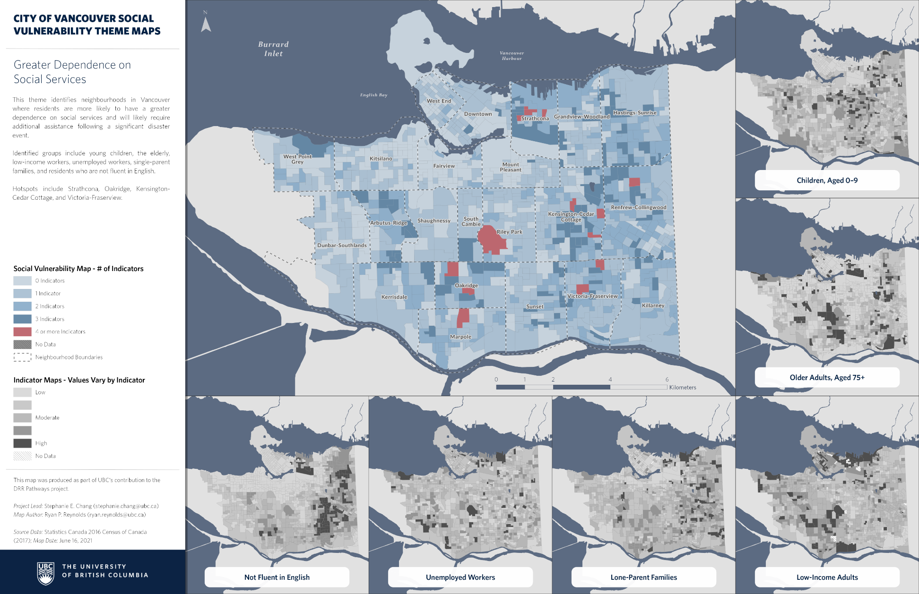
Theme 2: Dependence on Social Services
This theme identifies neighbourhoods in Vancouver where residents are more likely to have a greater dependence on social services and will likely require additional assistance following a significant disaster event.
Identified groups include young children, the elderly, low-income workers, unemployed workers, single-parent families, and residents who are not fluent in English.
Hotspots include Strathcona, Oakridge, Kensington-Cedar Cottage, and Victoria-Fraserview.
Notes:
Our second theme is dependence on social services. The theme integrates information from six indicators:
Young children, older adults, low-income adults, lone-parent families, unemployed workers, and those not fluent in English

Slide 12
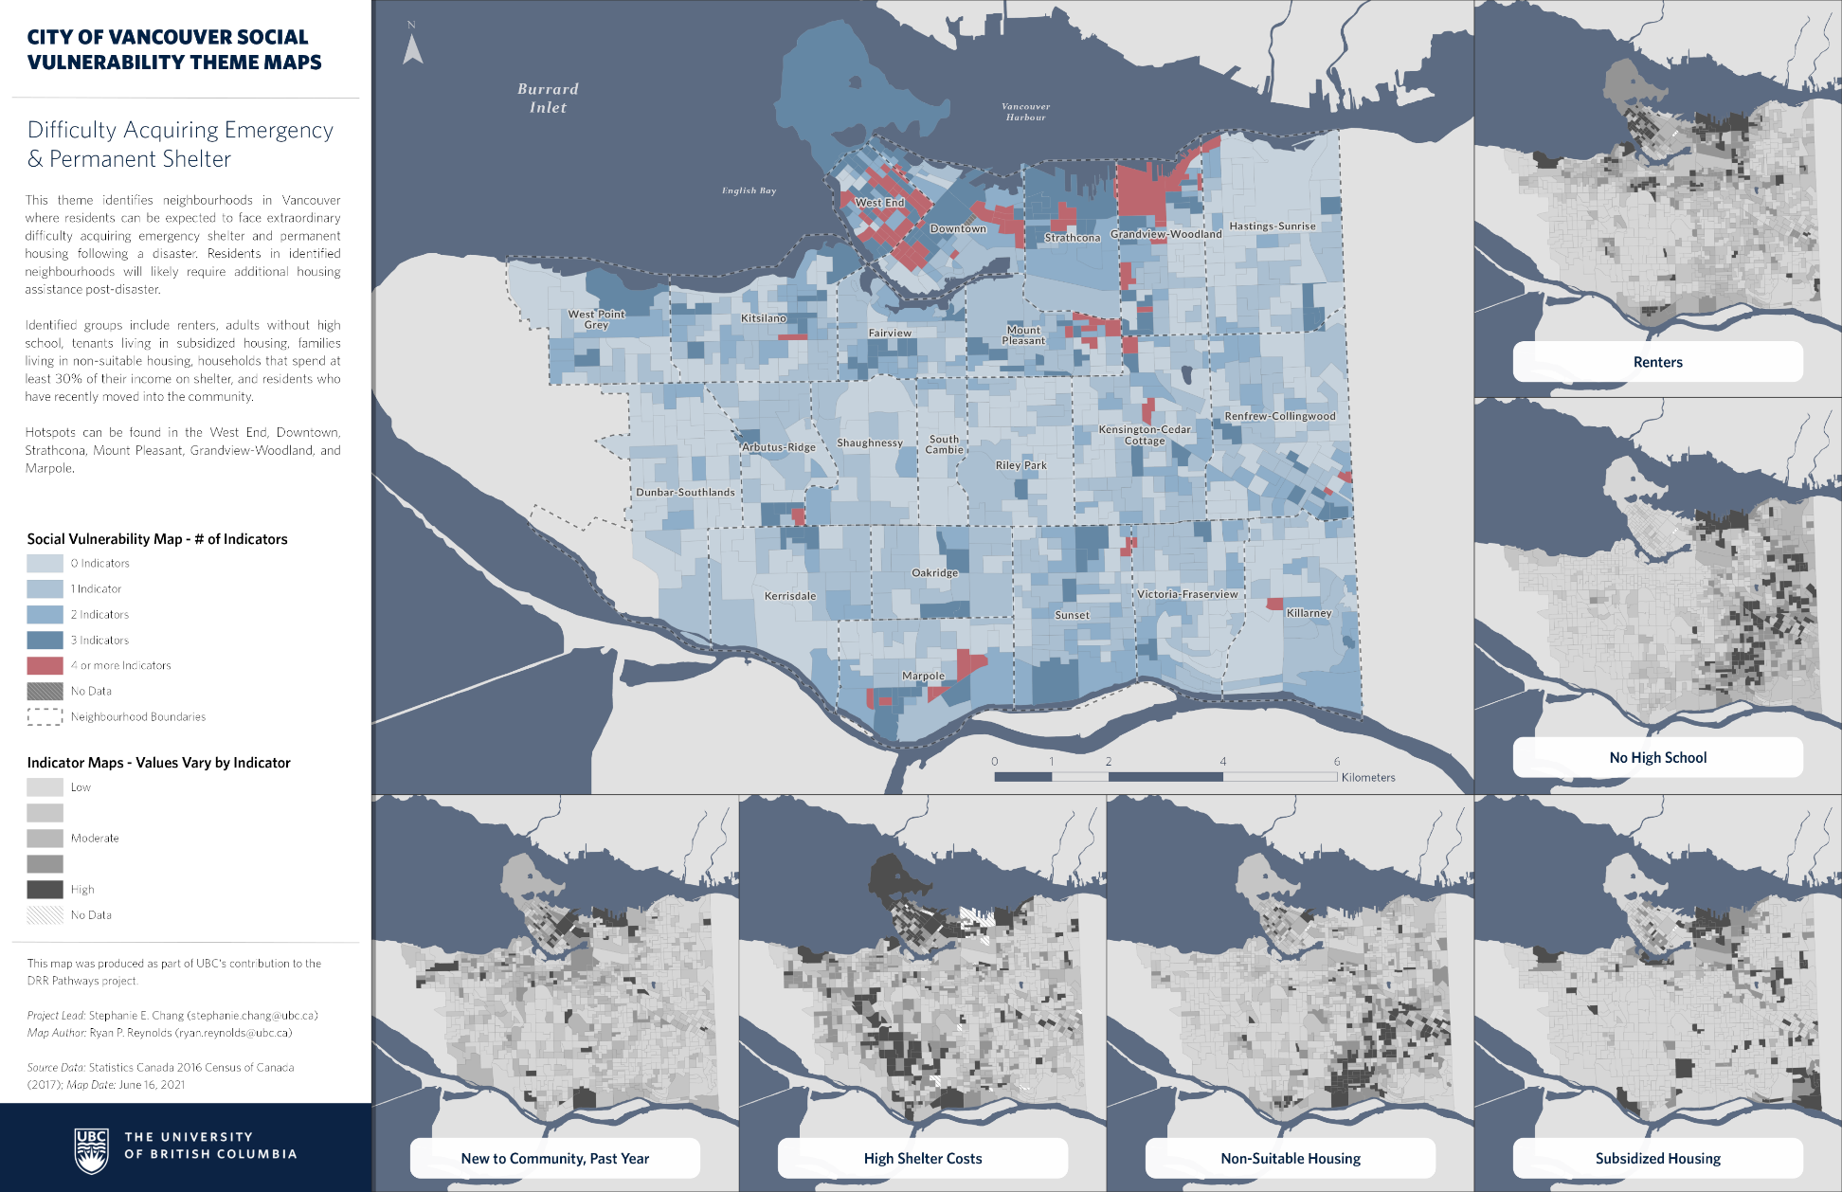
Theme 3: Difficulty Acquiring Shelter
This theme identifies neighbourhoods in Vancouver where residents can be expected to have difficulty acquiring emergency shelter and permanent housing following a disaster. Residents in identified neighbourhoods will likely require additional housing assistance post-disaster.
Identified groups include renters, adults without a high school certificate, tenants in subsidized housing, families living in non-suitable housing, households that spend at least 30% of their income on shelter, and residents who have recently moved into the community.
Hotspots include the West End, Downtown, Strathcona, Grandview-Woodland, Mount Pleasant, and Marpole.
Notes:
Our final theme explores difficulty acquiring emergency and long-term housing. The theme integrates information from six indicators:
Renters, those without a high school diploma (or equivalent), those living in subsidized or non-suitable housing, those who spend a significant portion of their income on shelter, and those who moved to the community within the past year.

Slide 13
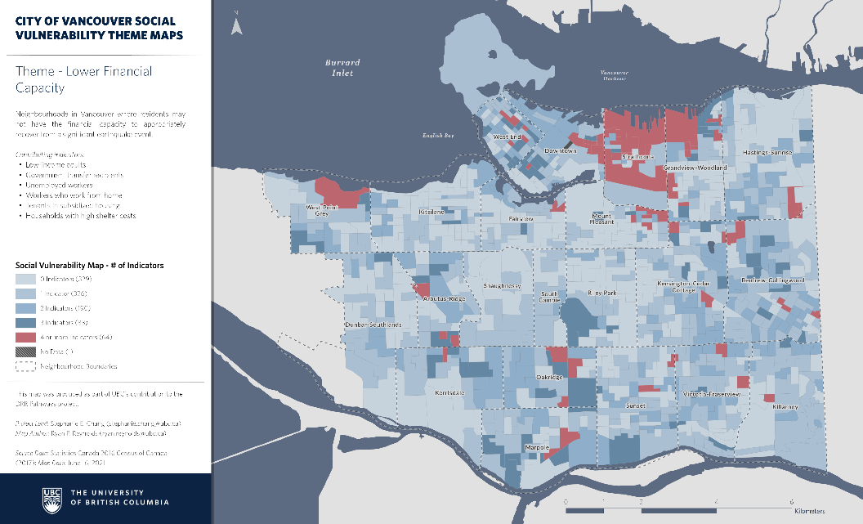
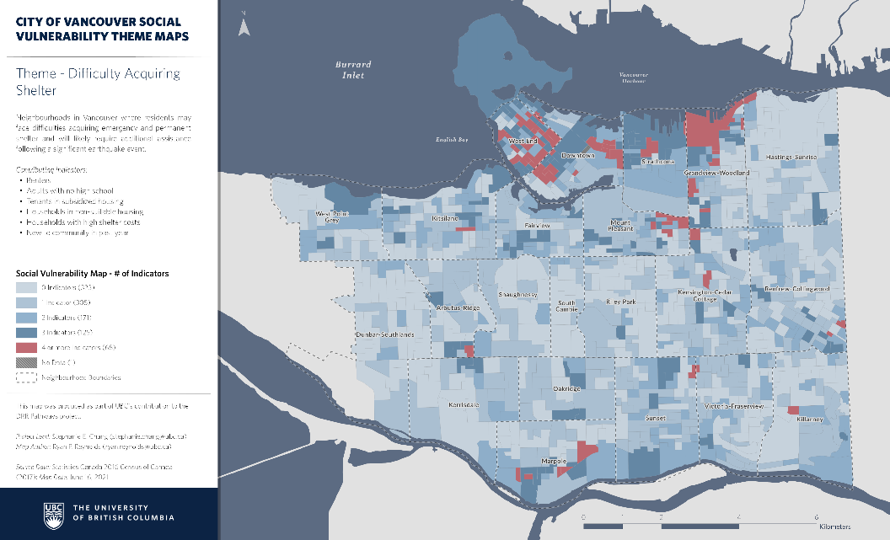
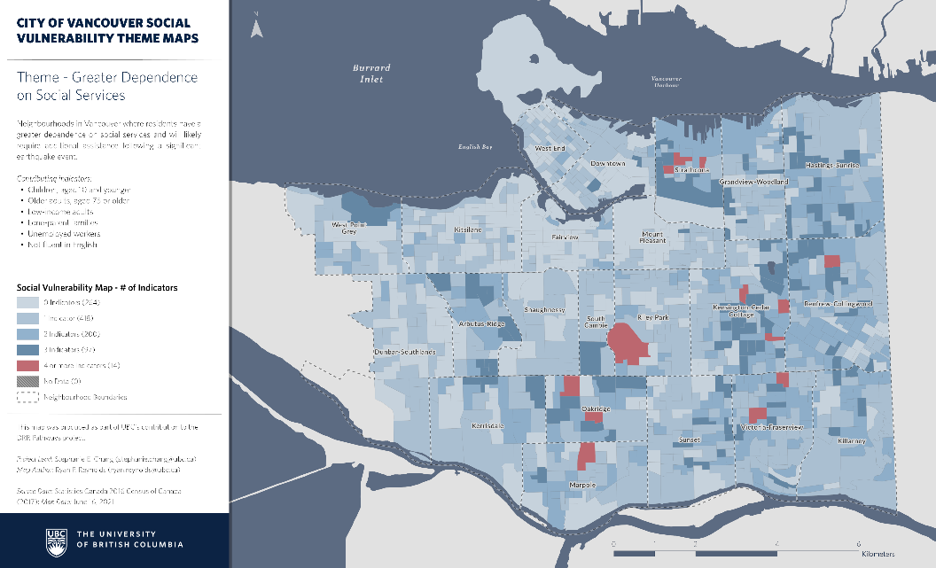
Social Vulnerability Across Vancouver

