Slide 1

BC Disaster Risk Reduction Hub
(BC DRR Hub)
Draft Proposal
For Discussion with Key Partners
May 19, 2020
Presenter: Sahar Safaie, Principal Consultant
Sage On Earth Consulting Ltd.
Email: Sahar.safaie@sageonearth.ca

Slide 2

Economic, structural,
legal,
social,
health,
cultural, educational, environmental, technological, political and institutional measures
Source: UNISDR
Notes:
The Goal:
Prevent new and reduce existing disaster risk through the implementation of integrated and inclusive economic, structural, legal, social, health, cultural, educational, environmental, technological, political and institutional measures that prevent and reduce hazard exposure and vulnerability to disaster, increase preparedness for response and recovery, and thus strengthen resilience.
You need to know your risk to make sure your work is goind to achieve the DRR objective

Slide 3
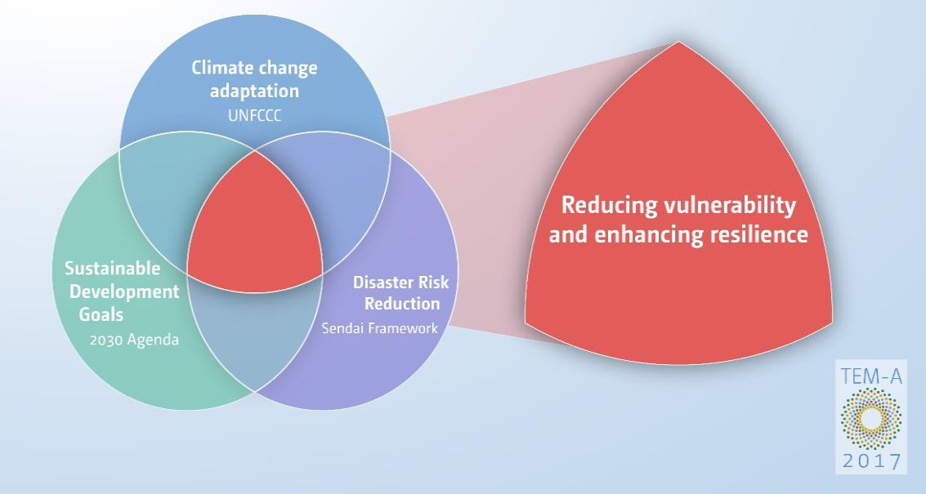
The common ground of Climate Change adaptation, Sustainable Development Goals, and Disaster Risk Reduction
Source: UNFCCC Technical Paper, FCCC/TP/2017/3

Slide 4
Common (and un-common) hazards that are the focus of CCA and DRR
Source: Sahar Safaie, 2018

Slide 5
The Challenge
The Persistent and Common Challenges in Conducting Hazard and Risk Assessments for Disaster Risk Reduction (DRR)
Risk assessments are conducted in silos of hazards and sectors
Available risk information is scattered and unorganized
Produced input/output data is not shared effectively
Risk assessments are conducted without benefiting from and building on existing work. As a result the price tag for new risk assessments is higher than it should be
Available risk information is not always used in policy design and investment
Available risk information is not communicated to stakeholders
Risk assessments are not always linked to DRR governance processes including policy development processes
Sectors have insufficient capacity to understand risk and use risk information
Notes:
Paradigm shift: Risk assessment is a process that allows shifting understanding of risk and change in behavior rather than pure numbers
Science-policy interface

Slide 6
Background for BC DRR Hub
2017-2018
URBC Symposiums
Stakeholders expressing the need for an organized and systematic approach towards understanding risk research, data management, and collaboration for DRR
DRR Pathways project launched with the concept of DRR Hub at the core of its objectives
Developing Theory of Change for DRR Hub and design of the core components
Engagement with Stakeholders through DRR Pathways Project
2019
Developing discussion paper for BC DRR Hub Governance and Financing Options
Discussing and establishing commitment from key entities in March-June
Sharing the vision and final options for BC DRR Hub with wider set of stakeholders at URBC Symposium
January- Sep URBC2020 Symposium

Slide 7
What is BC DRR Hub?
It is an an independent entity that coordinates science and policy partnerships to strategize and efficiently use available resources capabilities to respond to priority demands of stakeholders in disaster risk reduction. The focus is on production of multi-hazards and risks data and developing methods for using risk information in DRR across the province. Open data management and effective sharing of information and capacity development are also part of its core functions.

Slide 8
The Goal
Building A Resilient Future for BC
The Objectives
Advancing
Understanding Risk
Improving data and scientific methodologies for multi-risk assessments to support disaster risk reduction policies in a more harmonized and strategic way
Enabling use
of Risk Information in DRR
Researching and developing analytical tools and methodologies for using risk information in the design and implementation of legislations, policies, investments, and projects
Enhancing Access to Data, Information, and Knowledge
Establishing and promoting wide use of a data platform that enhances access to multi-hazard and multi-risk data, with the appropriate data standards, data sharing protocols and maintenance mechanisms
Increasing Connection and Collaboration between Science and Policy
Enhancing quantity and effectiveness of collaboration in data collection, research and modeling, and in design and implementation of risk-informed resilience policies, investments, and projects

Slide 9
What challenges BC DRR Hub will tackle?
Risk data accessibility and data sharing modalities
Understanding and using risk information in DRR
Identifying common needs and priorities for effective DRR work across hazards and sectors
Coordination and collaboration across projects, hazards and sectors

Slide 10
Who does it serve?
BC DRR Hub serves practitioners, decision makers, and researchers active in understanding risk and DRR in public and private by direct interactions as members and users of the Hub. It serves the whole of society as the ultimate beneficiaries of DRR in BC.

Slide 11
What is BC DRR Hub value proposition?
Enhancing understanding risk and DRR across the province and improving efficiency in use of financial resources and expertise by:
Avoiding duplication of efforts in conducting risk assessments across projects, hazards, and sectors
Gaining more from hazard and risk assessments by transforming reliable data into actionable information for use by a wide range of users beyond the scientific community
Ensuring research, modeling, and developed tools are relevant to serve priority topics for disaster risk reduction by enabling a space to co-design and co-development by scientific researchers and practitioners.

Slide 12
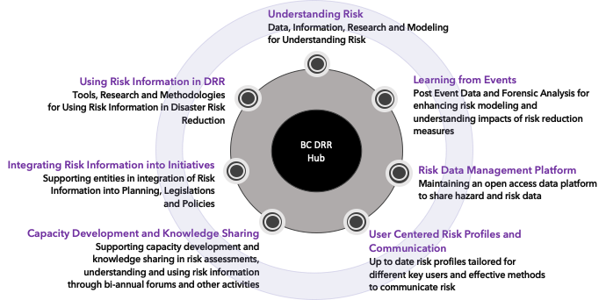
The Core Components and Activities
Implemented by the Hub and Partners
Supported by A Strong Governance and Financing Mechanism

Slide 13
Core Founding Institutions
Natural Resources Canada
Public Safety Canada
Emergency Management BC
Ministry of Municipal Affairs and Housing
BC Climate Action Secretariat
Ministry of Forests, Lands, Natural Resource Operations and Rural Development

Slide 14
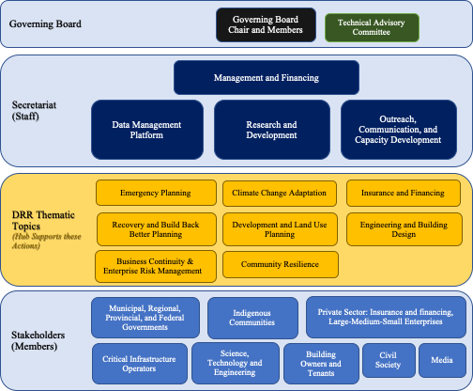
Notional Institutional Structure

Slide 15
Hazards of Concern:
Start with Earthquakes and Floods (coastal, urban, riverine) and at a later stage include Wildfires, Sea Level Rise, Tsunamis, and Landslides.
The Hub connects with key relevant initiatives such as:
Municipal DRR policies and plans including Emergency Management Plans and Resilience Strategies
Metro Vancouver Regional Growth Strategy and Climate 2050 Planning
Emergency Program Act Modernization
BC Climate Change Adaptation Strategy
BC Flood Risk Strategy
Lower Mainland Flood Management Strategy
Update to BC Existing Buildings Regulation
NRCan Risk Data Platform and Canada Earthquake Risk Model
National DRR Roundtable and Platform

Slide 16
Timeline

Slide 17
Financial Needs of the Hub
Financial needs of the DRR Hub can be categorized as following:
Staff salary
Running the core programs:
    Data management platform
    Risk profiles of Jurisdictions (or interactive automated risk profiling)
    Bi-annum Forum
    Bi-annual strategic report on the status of understanding risk in BC, use of risk information in DRR, and gaps and recommendations
    Capacity building programs
Research in multi-hazard risk modeling and methods for using risk information in DRR policy and planning
Physical Capital (Office space/soft and hard infrastructure)

Slide 18
Q/A - Discussion

Slide 19
Acknowledgements
Articulation of challenges and call for action from stakeholders in BC attending Understanding Risk symposiums in 2017 and 2018
Significant technical and financial support from NRCan in convening stakeholders and developing the concept
Preliminary concepts adapted from “Understanding Risk System (URS): An essential foundation for implementing the Sendai Framework“, Safaie. S., Alfonzo Santamaria. N., Houdijk, R., Onur. T., 2018
Significant inputs from DRR Pathways project steering committee members attending the “theory of change” workshop in July 2019
Sage On Earth Consulting and Susanna Haas designing and facilitating the theory of change workshop
EMBC, MAH, CAS, PSC institutional support and inputs to the DRR Hub design proposal
Sage On Earth Consulting developing the DRR Hub design proposal

