Slide 1
NRCan OpenDRR Platform
Technology Brief

Slide 2
Stated objective
“The OpenDRR platform aims to provide tools to investigate, assess, and mitigate natural disasters for policy makers, risk analysts, private and public institutions, and citizens to facilitate decision-making prior to a crisis.”
Requirements compiled by Minerva: https://opendrr.github.io/documentation/docs/opendrr-platform.html

Slide 3
Motivation – Policy on Service and Digital
Principles:
design with users
iterate and improve frequently
work in the open by default
use open standards and solutions
collaborate widely
There are protocols and workflows to facilitate this!

Slide 4
Motivation – Open Science Initiative
To make Canadian science open to all, maximizing benefits for the well-being, health and economy of our country.
Deadline is 2022-2023 for all GC scientific articles and publications to be open by default.
Notes:
The FAIR Data Principles are a set of guiding principles in order to make data findable, accessible, interoperable and reusable (Wilkinson et al., 2016). These principles provide guidance for scientific data management and stewardship and are relevant to all stakeholders in the current digital ecosystem. They directly address data producers and data publishers to promote maximum use of research data. Research libraries can use the FAIR Data Principles as a framework for fostering and extending research data services.

Slide 5
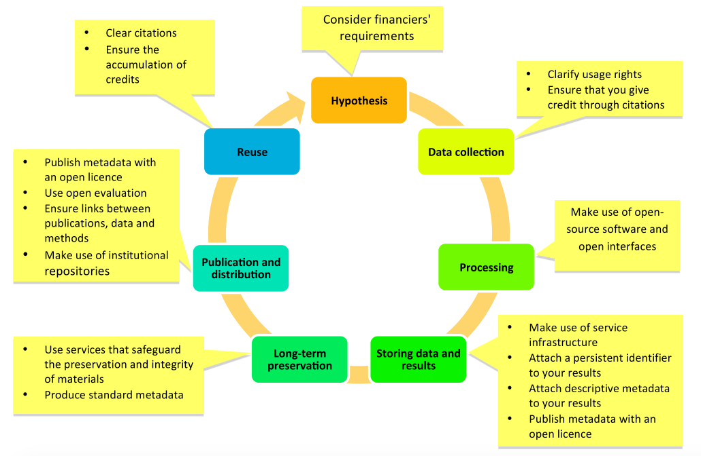
Promoting openness at different stages of the research process (from https://www. fosteropenscience.eu)
Notes:
Stages of the research process

Slide 6
Primary Users*
Risk Analyst
Generate scenario outputs
Allow for peer-review of outputs
Disseminate outputs
Emergency Manager, Land-Use Planner, Risk Manager
Access to up-to-date hazard scenarios
Access to scenario outputs and datasets
Ability to integrate scenario data into a GIS
Individual/business
Intuitive and context aware access to hazard scenarios
High level overview of risk
Natural language descriptions and simple but effective visualizations
* Taken from requirements compiled by Minerva: https://opendrr.github.io/documentation/docs/opendrr-platform.html

Slide 7
Workflow
Refine
Model Scenarios
Generate Scenario Outputs
Peer Review
Publish
Share

Slide 8
Key Components
RiskProfiler
FGP
OpenQuake Engine
GitHub Repository
Federal Geospatial Platform (FGP)
Public Portal (RiskProfiler.ca)
GitHub
OpenQuake Engine

Slide 9
Open Quake Engine
GEM’s state-of-the-art, open-source software collaboratively developed for earthquake hazard and risk modelling
Generates raw scenario outputs for further processing
Risk Analysts push outputs to the GitHub data repository
OpenQuake Engine
Scenario Outputs
GitHub
Notes:
The OpenQuake Engine is an open source application that allows users to compute seismic hazard and seismic risk of earthquakes on a global scale.

Slide 10
GitHub Repository
OpenQuake Engine
Version scientific assets
Facilitate peer-review and editing (Private Repo)
Facilitate broader dissemination (Public Repo)
Collaborate
Fork it!
Provide a feedback loop
Promote transparency
Scenario Outputs
GitHub

Slide 11
GitHub Repository
OpenQuake Engine
Deployable solutions
Infrastructure as code (i.e. Containers)
Software code
Robust documentation
Code samples
Risk Indicators
Scenario Outputs
Model Factory
Spatial Database
GitHub

Slide 12
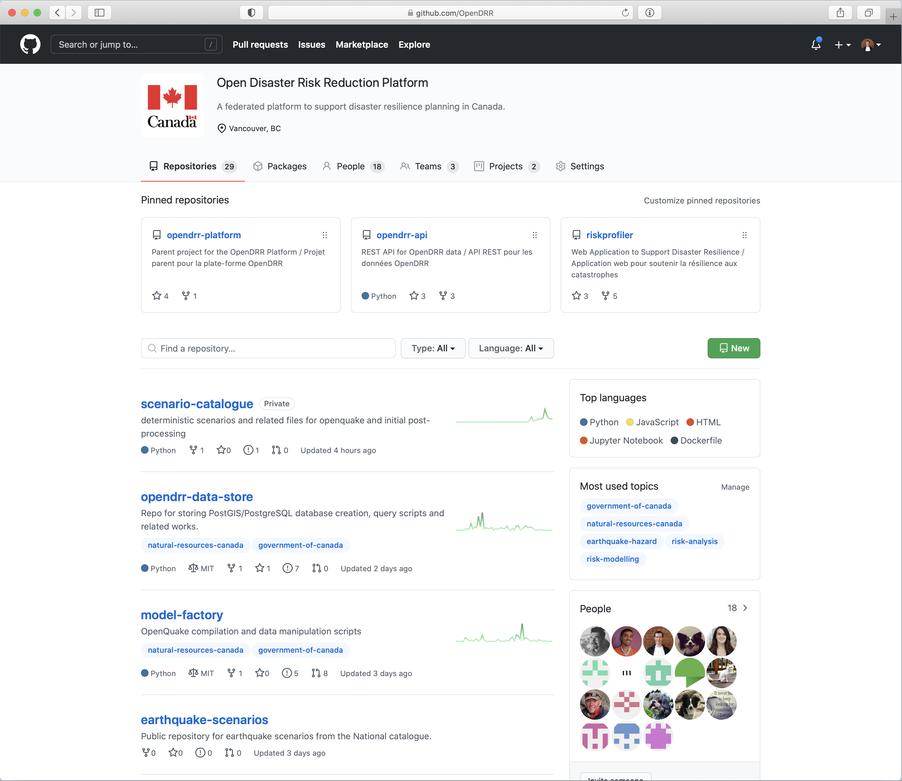

Slide 13
Federal Geospatial Platform
CGP
Open Data
F/P/T Portals
Emergency Theme
Geospatial clearinghouse for the GC
Enterprise grade turn-key services with the Geo-Community Cloud (GCC)
No need to reinvent the wheel – leverage existing infrastructure
Primary path to Open Data Portal
Sustainability is a driver
Public FGP coming soon!
FGP
CSW
FGP GCC
OGC
Esri REST
WPS (CZS)
OpenDRR GitHub

Slide 14
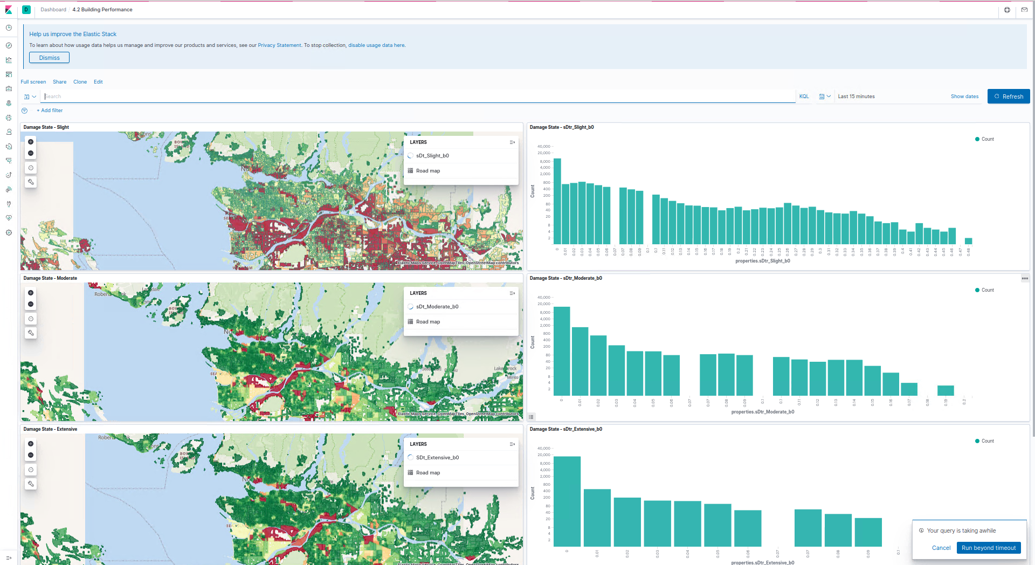
Public Dashboard (Experimental)
Pre-generated dashboards with visualizations
Allows users to query underlying models and visualize results using charts, graphs, and maps
Users can share results outside of the platform
Kibana
Elasticsearch
OpenDRR GitHub
Launching in 2021
Spatial Database

Slide 15
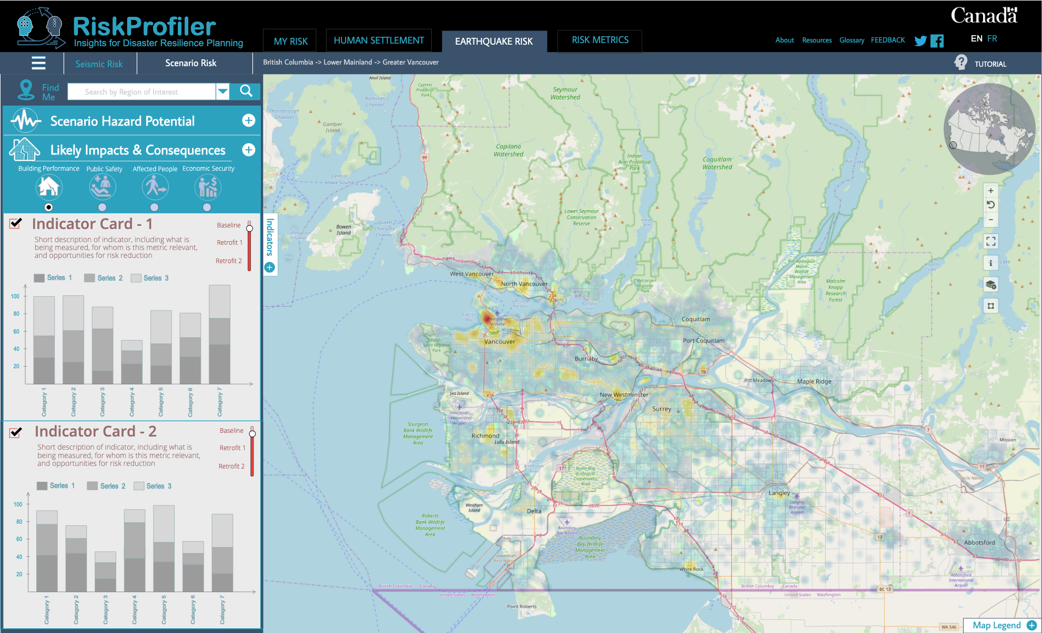
RiskProfiler.ca
Currently in design phase!
Purpose-built web application for non-experts
High-level overview of hazard risk
Interactive maps and graphic visualizations with supporting text
OGC API
Elasticsearch
OpenDRR GitHub
Launching in 2021
Spatial Database

Slide 16
Dashboard
RiskProfiler
CGP
Open Data
F/P/T Portals
Emergency Theme
OGC API
Metadata
Services
Elasticsearch
Risk Analyst
Federal Geospatial Platform
Emergency Planner
Web Services
Spatial Database
GC User
Public
Risk Indicators
Enterprise Cloud Services
Standards
Best of breed
Scalable
Download
Models
Datasets
Documentation
OpenQuake Engine
OpenDRR GitHub

Slide 17
For more information
Reach me at: joost.vanulden@canada.ca
Find us at:
https://github.com/OpenDRR

Slide 18
RiskProfiler
Community Planners
Emergency Managers
Financial Analysts
Insurance Sector
Individuals
Businesses
Technical Experts
GOAL: Create a web platform to share information and increase understanding of risk among multiple end users.

Slide 19
Notes:
This work started with some motivating questions, which have informed the progress made.

Slide 20
Progress (DRRP & EMS)
Building and documenting understanding of users
Report from Minerva Intelligence funded by DRRP
Working with developers to refine intended functionality
Development of back end and data architecture
Creation and review of wireframes

Slide 21
Model Factory
Transform raw earthquake model results into actionable spatial information that can be integrated into a GIS
Portable and flexible ETL (Extract Transform Load) processes leveraging Python, SQL and PostGIS
Validation of underlying data
Data ingest
Sendai indicator view generation
Index data into API service
Aggregated at Neighborhood level
Ongoing development in the open. Source code freely available on Github (https://www.github.com/OpenDRR/model-factory)
Model Outputs
Model Factory
Spatial Database
Elasticsearch
OpenDRR GitHub

Slide 22
Developer Friendly
Open API Document
Provide multiple points of access to critical data such that it can be integrated into web applications and desktop GIS
Developer portal with interactive query builder
GitHub pages
GeoJSON representations of outputs
GeoPackage representations available for download
Scenario documentation
OpenDRR GitHub
GitHub pages
GeoJSON
GeoPackage
Documentation

Slide 23
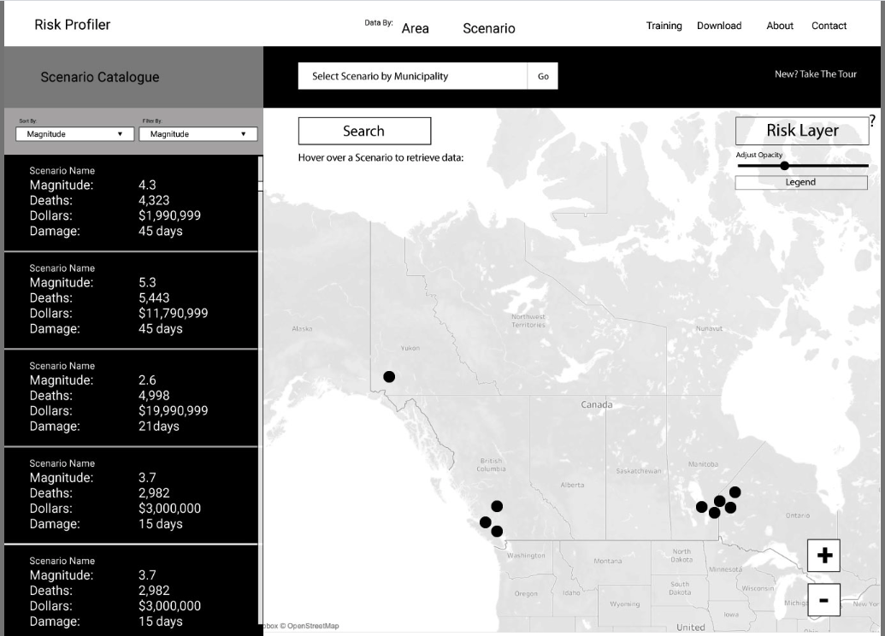
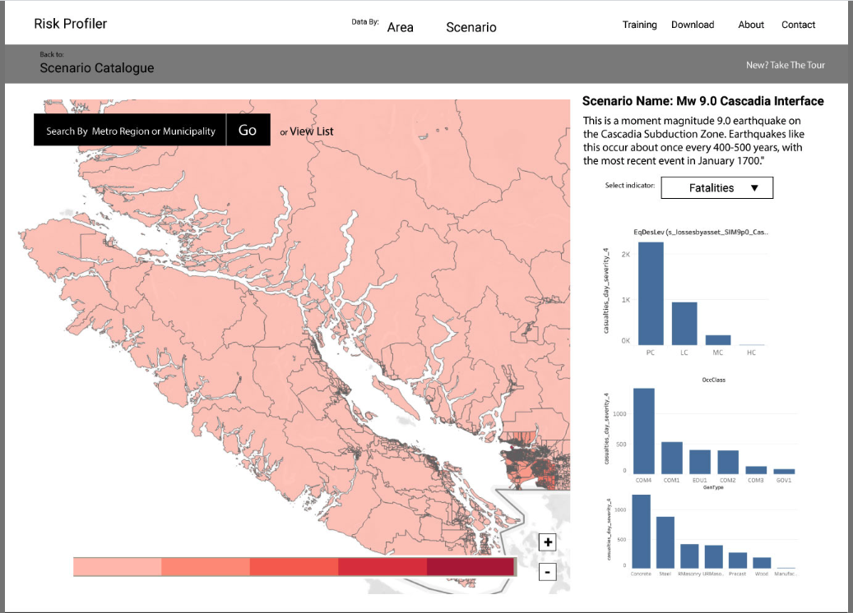
Wire Frames
Interactive maps and graphic visualizations
Downloads for technical users
Guidelines & Educational Experiences for practitioners

Slide 24
Timeline to Completion

