Slide 1
Structural Fragility and Vulnerability Modelling DRR-Pathways Project
Presented by:
Ann Abraham, Ph.D. Candidate
Armin Bebamzadeh, Ph.D., P.Eng.
Carlos E. Ventura, Ph.D., P.Eng., Director of Earthquake Engineering Research Facility, UBC

Slide 2
Introduction:
Fragility and vulnerability functions for generic building typologies in a region are essential to estimate seismic risk on a regional level and make appropriate decisions.
probability of expected damages
probability of expected losses
Fragility curves generated based on site specific seismic hazard are essential to get an accurate assessment of seismic risk.
Work done in collaboration with NRCan and Global Earthquake Model, Pavia. Fragility functions so produced to be used towards the National Seismic Risk Model.

Slide 3
WHY THIS WORK MATTERS:
The fragility functions developed are necessary to identify pockets within the city where there could be a concentration of structural damages and possible collapses during specific seismic events. These regions could be monitored for further emergency actions during seismic events.
It also helps identify specific building typologies within a region in the city that needs to be considered specifically for seismic retrofit to keep damage to acceptable levels during specific seismic events.
The vulnerability functions developed are used to assess the potential losses during specific seismic events and can be used for decision making for disaster risk reduction policies and investments.
The fragility curves for different seismic source types (Crustal, Subduction) can be used to understand and quantify the effect of a specific source type on regional seismic risk assessment i.e., when and where in Canada, the effect of subduction earthquakes influences the overall losses/damages in a regional seismic risk assessment.

Slide 4
WORK DONE POST 2019:
Exposure Model:
BC building stock investigation by UBC through an extensive building survey to document main building typologies in the Vancouver
Classification of buildings to different typologies
Introducing BC-specific building typologies:
Evaluation of the fragility functions provided on the OpenQuake platform and their applicability to Canada
Review of Canadian construction and design by Buildings At Risk Sub-committee of the Seismic Policy Advisory Committee of the City of Vancouver towards creation of reliable building models of the most prominent building typologies in British Columbia to develop BC-specific structural damage models.
Introduction of new building typologies specific to BC construction, such as W3 and W4c, W4s.
Fragility curves:
Development of new BC-specific fragility functions for predominant building typologies in BC for both crustal and subduction sources.
PEER review of fragility functions developed towards damage estimation during seismic events, for the predominant building typologies in BC (June 2020)
Revisiting and fine tuning it to better represent BC specific generic buildings to reflect construction design practices in regional scale for each of the prominent typologies.
Developing building models for new building typologies and developing corresponding fragility and vulnerability functions.
Revisiting fragility curves especially those for subduction scenario to better represent behaviour under long duration ground motions
Vulnerability curves:
Development of new BC-specific structural, non-structural and contents vulnerability functions for predominant building typologies in BC for both crustal and subduction sources.

Slide 5
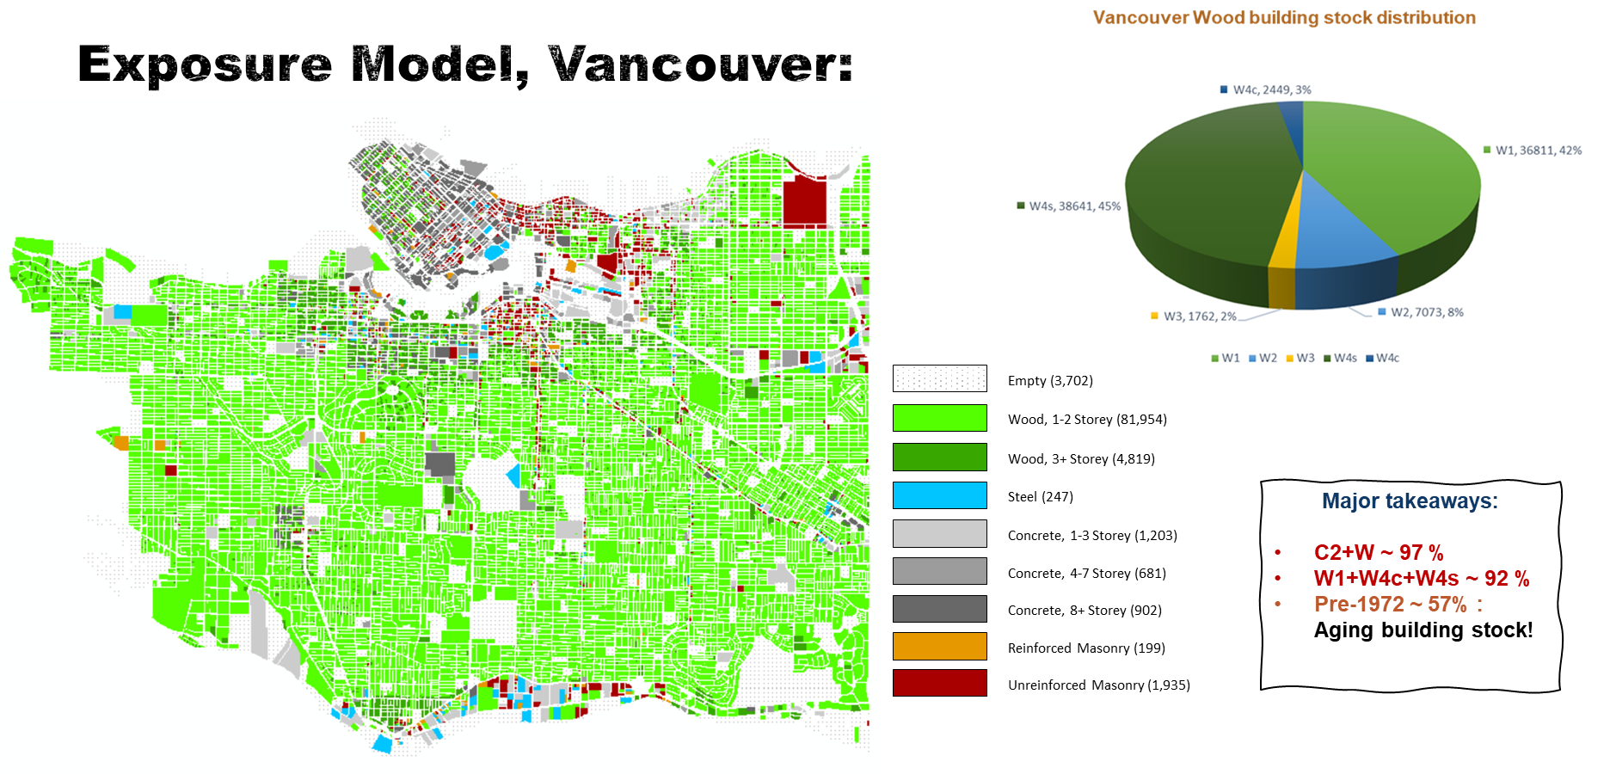

Slide 8
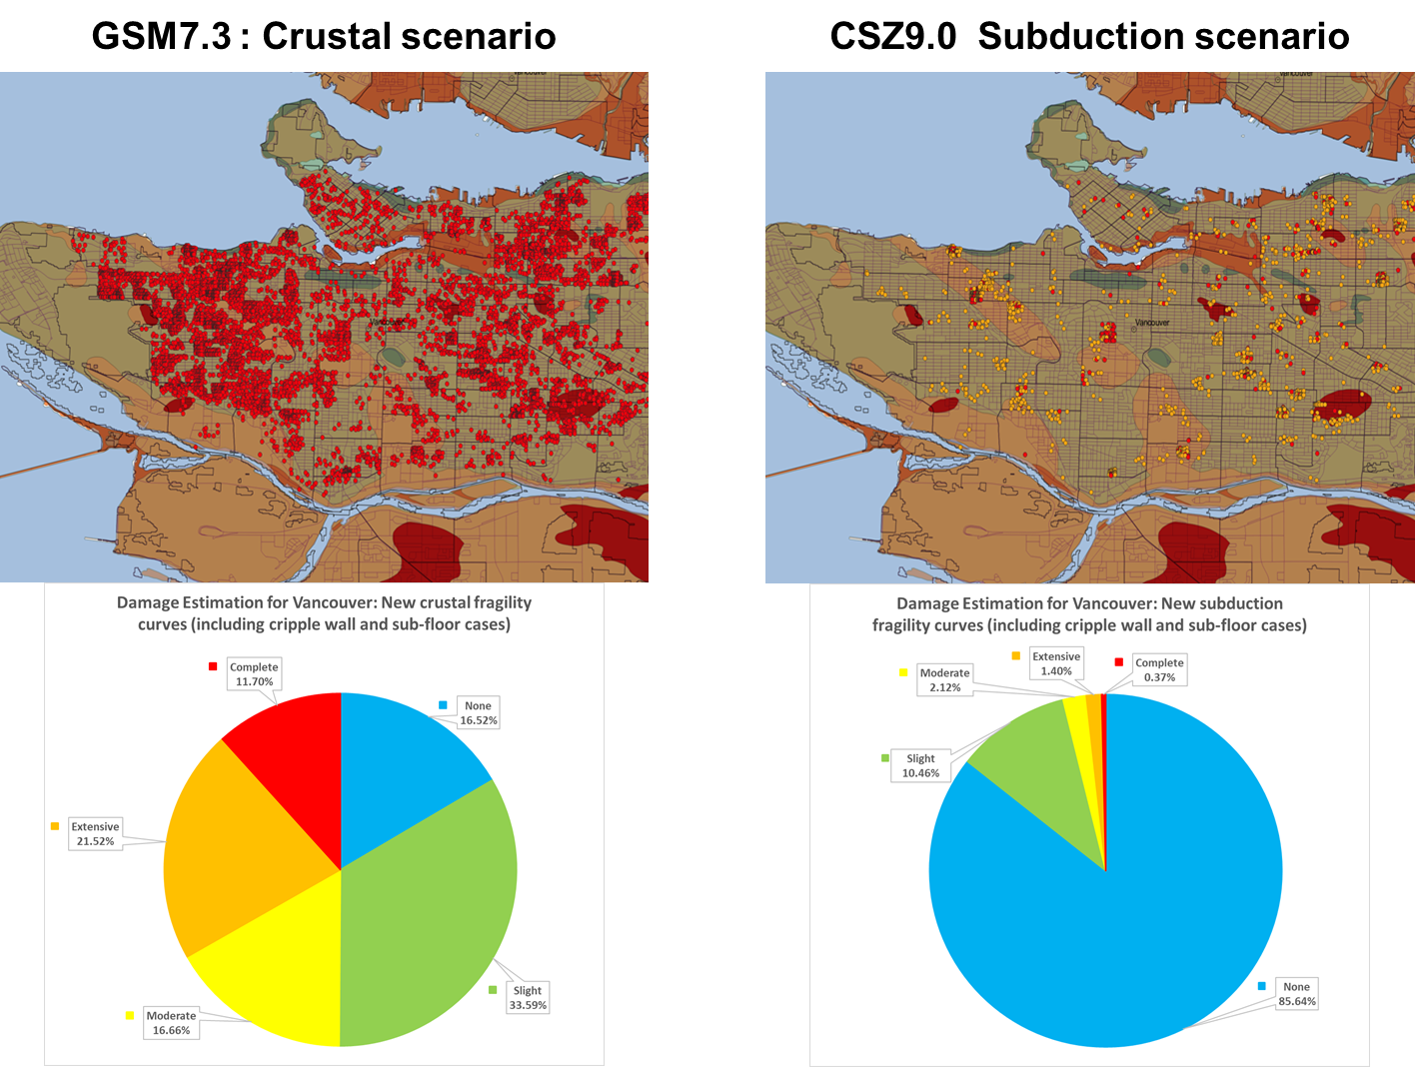

Slide 9
Results:
For low-rise wood typologies and concrete shear wall construction built after 1990 in Vancouver, damage under both crustal and subduction scenarios is grossly underestimated when using the current fragility curves.
Careful consideration should be paid to single family wood houses with crawl space underneath (cripple-wall) or basement (sub-floor) that were built prior to 1990, which constitute a large portion of the Vancouver building stock. These homes can develop soft-storey effects under strong shaking, and are highly susceptible to damage.
Subduction earthquakes influence the fragility curves, especially the higher damage limit states, and more so, for building built after 1990. The collapse potential due to subduction events is greater than that for crustal events.
Higher extensive and complete collapses are noted when using fragility curves developed using subduction earthquakes compared to crustal earthquakes when running the subduction scenario, especially in softer soils.
The fragility curves are very sensitive to modelling changes, thresholds for damage states that are set, strength of the structure, and ductility of the structure, especially for the higher damage states.
Losses and damage are driven by concrete shear wall buildings and multi-storey wood construction built before 1973, and low-rise wood construction with cripple walls.

Slide 10
THANK YOU !

