Slide 1
DRR Pathways: Neighbourhood Recoverability in the City of Vancouver
Assessment of community resilience and recoverability indicators at the neighbourhood scale, and metrics that can be used to assess peri- and post-disaster recovery
Ryan P. Reynolds, Postdoctoral Research Fellow ryan.reynolds@ubc.ca
Notes:
Completed in September 2019

Slide 2
Neighbourhood Recoverability
Recoverability refers to the projected capacity of a neighbourhood or community to return to an acceptable level of functionality, estimated prior to a disaster event
More recoverable neighbourhoods are characterised by economic stability, strong social capital, a more resilient built environment, and good accessibility to key goods and services, including transportation, healthcare services, and food
While many indicators of recoverability overlap with those of vulnerability and resilience, recoverability indicators explicitly explore a neighbourhood’s post-disaster ability to facilitate recovery

Slide 3
Exploring Neighbourhood Recoverability in the Vancouver Region
Our team partnered with the University of Victoria, Defense Research and Development Canada, Natural Resources Canada, and Sage on Earth to identify Vancouver neighbourhoods that have low abilities to recover following a disaster
The project aims to help policymakers determine which neighbourhoods could benefit from efforts to improve resilience and help reduce barriers to future post-disaster recovery

Slide 4
Recoverability Themes
Access to Goods and Services
Neighbourhoods having higher accessibility to goods and services to meet a variety of post-disaster needs
Business Recoverability
Businesses that are more economically stable and sustainable following a disaster
Resident Recoverability
Neighbourhoods with residents that have higher socio-economic capacity, allowing them to recover more quickly following a disaster

Slide 5
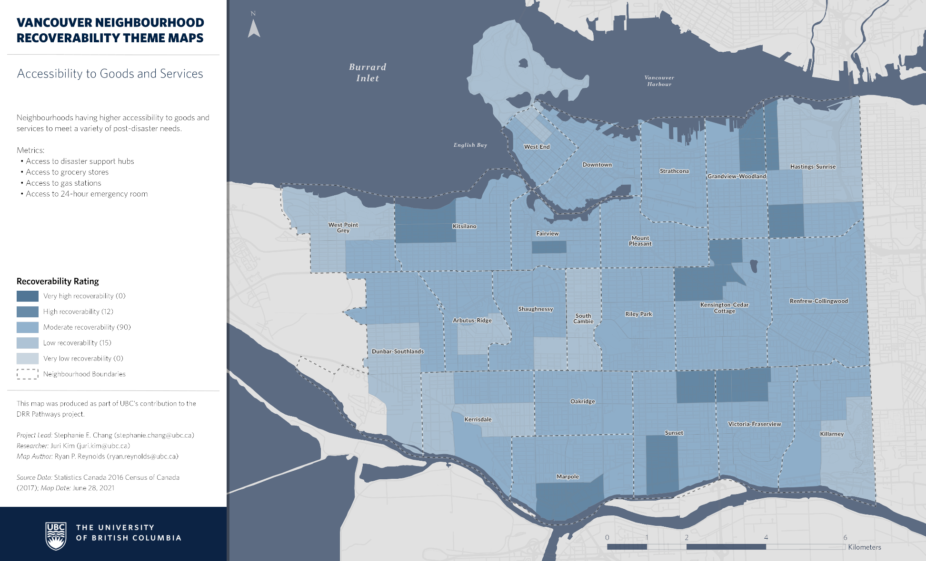
Theme 1: Accessibility to Goods and Services
This theme identifies neighbourhoods in Vancouver having a higher accessibility to goods and services that meet a variety of resident and business needs following a disaster
Specific measures that make up the theme include access to disaster support hubs, grocery stores, gas stations, and 24-hour emergency rooms
Indicators either measure the number of facilities within a given travel distance or the travel time to the nearest facility

Slide 6
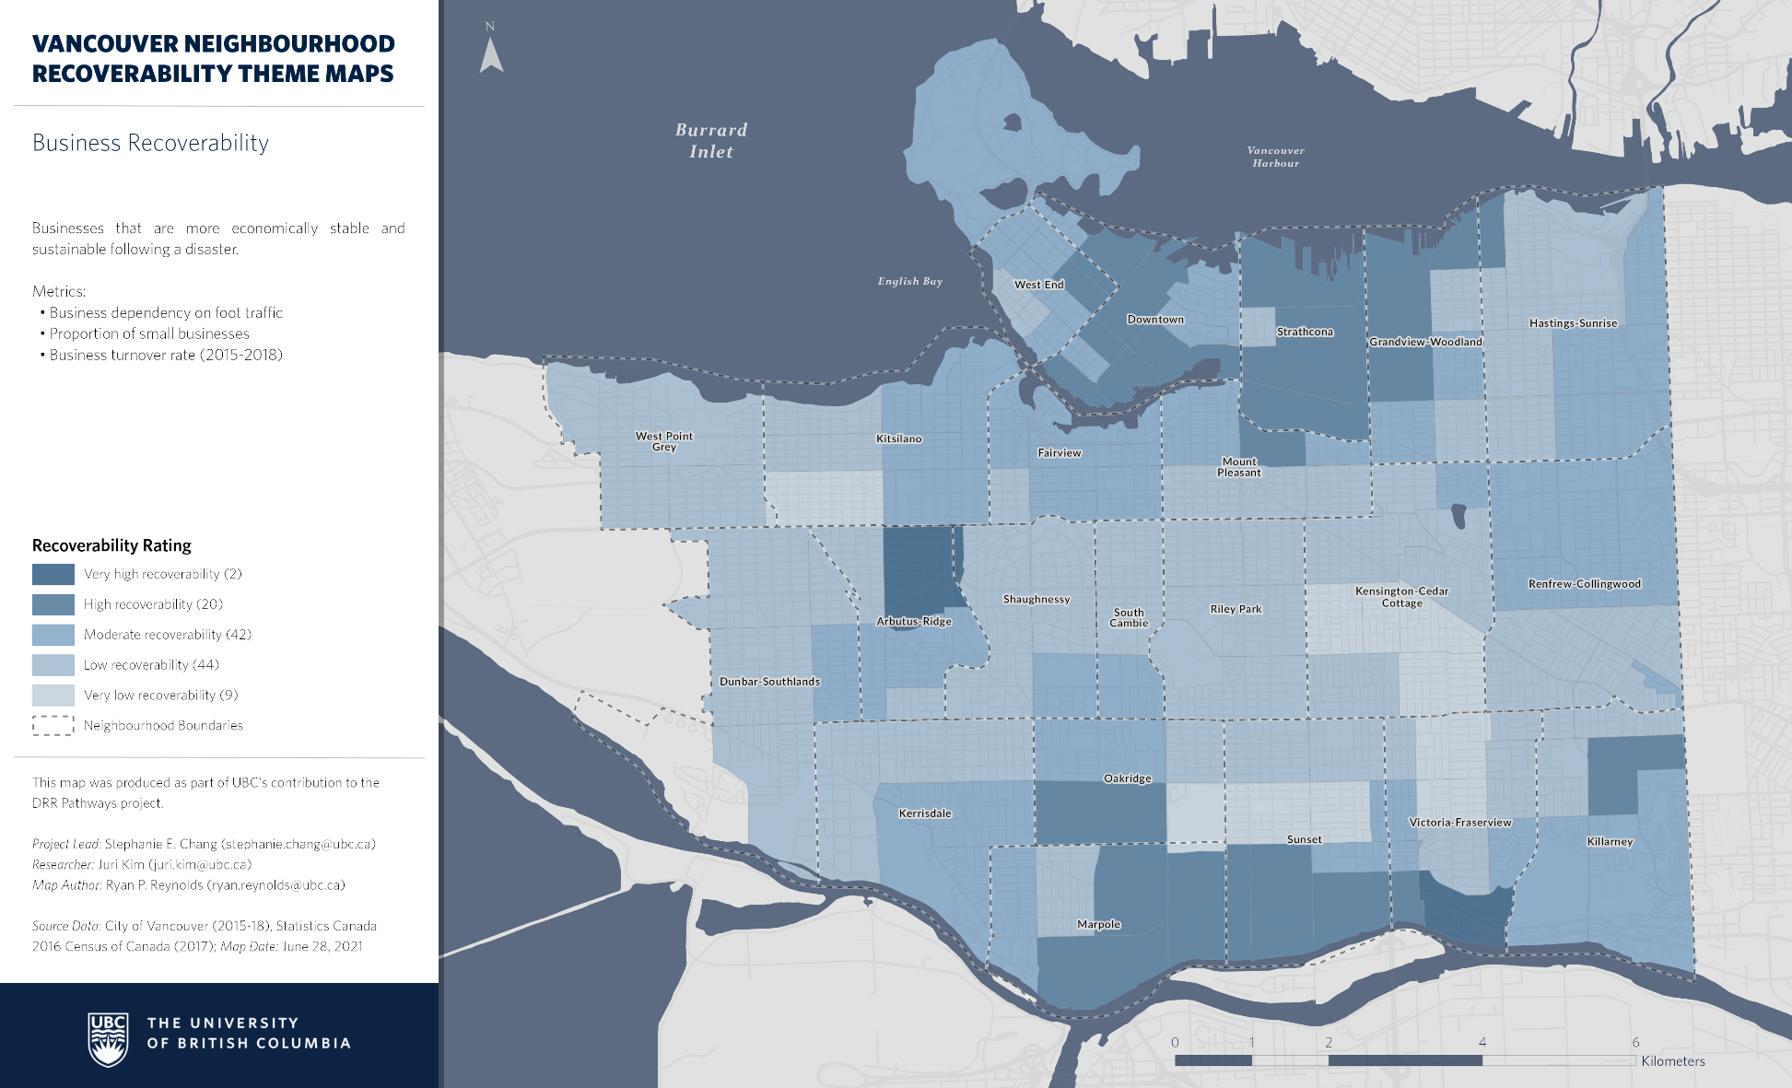
Theme 2: Business Recoverability
This theme identifies neighbourhoods in Vancouver where businesses have stronger economic stability and sustainability following a disaster
Specific measures in the theme include business dependence on foot traffic, the proportion of smaller businesses, and the neighbourhood business turnover rate (2015–2018)
Indicators are derived from the City of Vancouver’s business license database

Slide 7
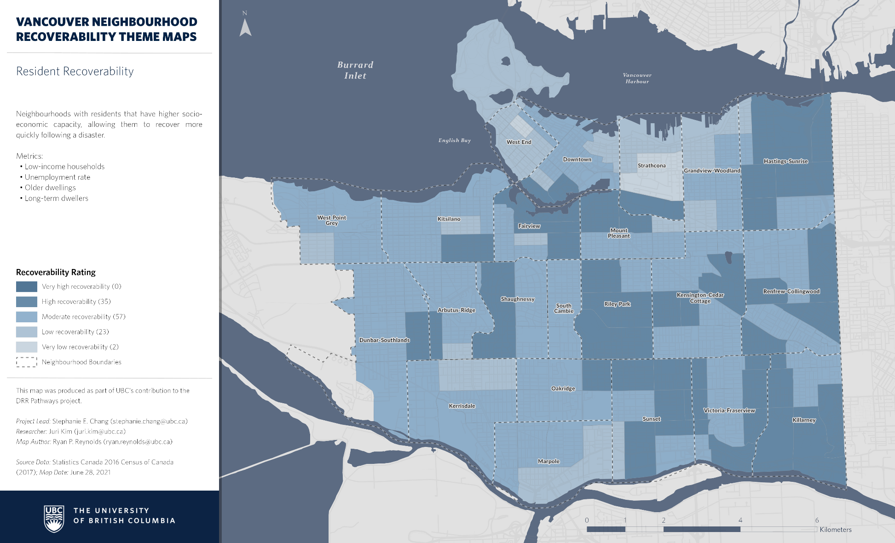
Theme 3: Resident Recoverability
This theme identifies neighbourhoods in Vancouver where residents’ socio-economic capacity affects their ability to recover more quickly following a disaster
Specific metrics in the theme include proportion of low-income households, unemployment rate, the number of dwelling units built prior to 1981, and the proportion of long-term dwellers.
Indicators rely upon statistics from the 2016 Census.

Slide 8
Interproject Connections
We worked with Paul Chouinard (DRDC) and David Bristow and Andrew Deelstra (UVic) to explore how the concept of recoverability could build on their work into critical infrastructure and recovery planning
As an experiment, we explored neighbourhood access to a 24-hour emergency room for several points following a significant earthquake event

Slide 9
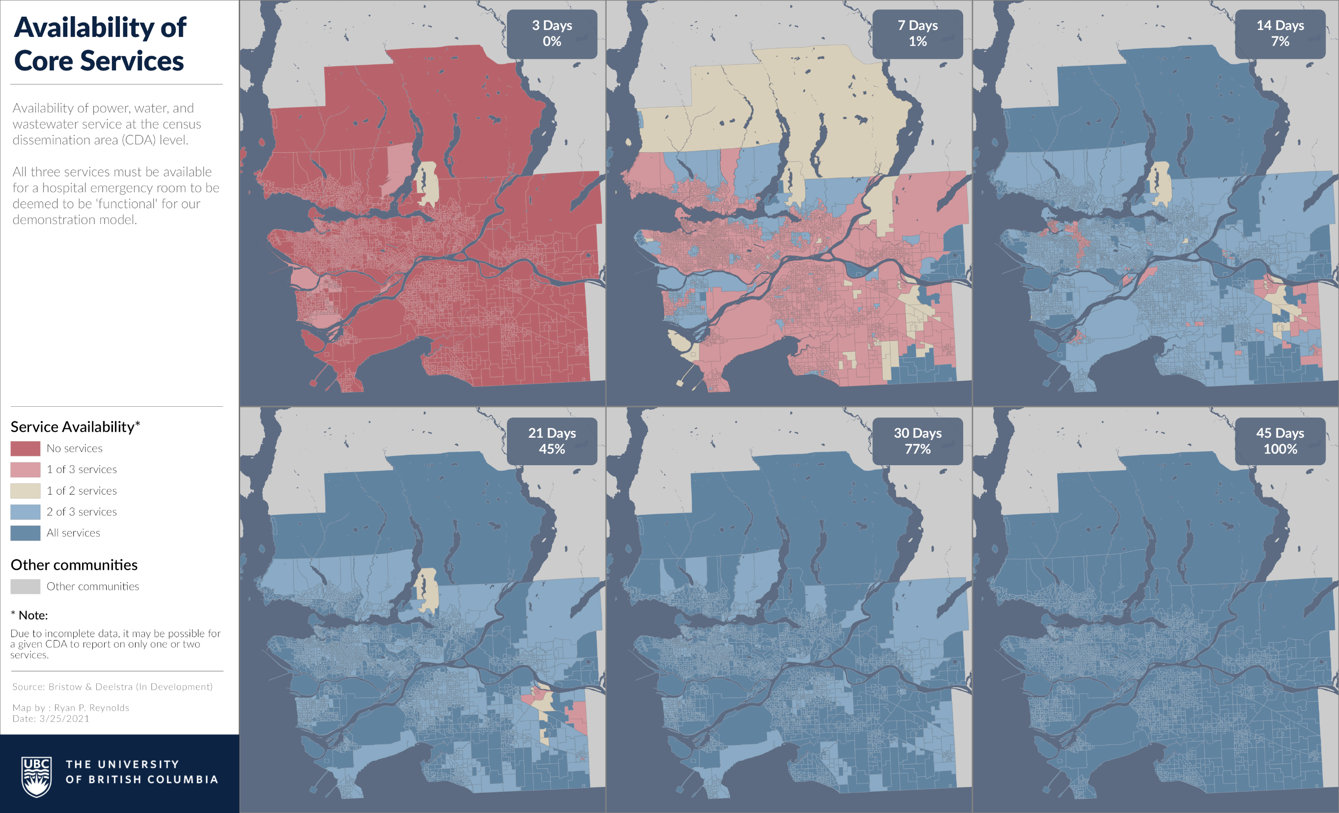
Notes:
Building on the work from UVic & DRDC, we established neighbourhood recovery times for three major services: power, water, and wastewater
Access to critical infrastructure services was established for each census dissemination area for six points following a potential earthquake

Slide 10
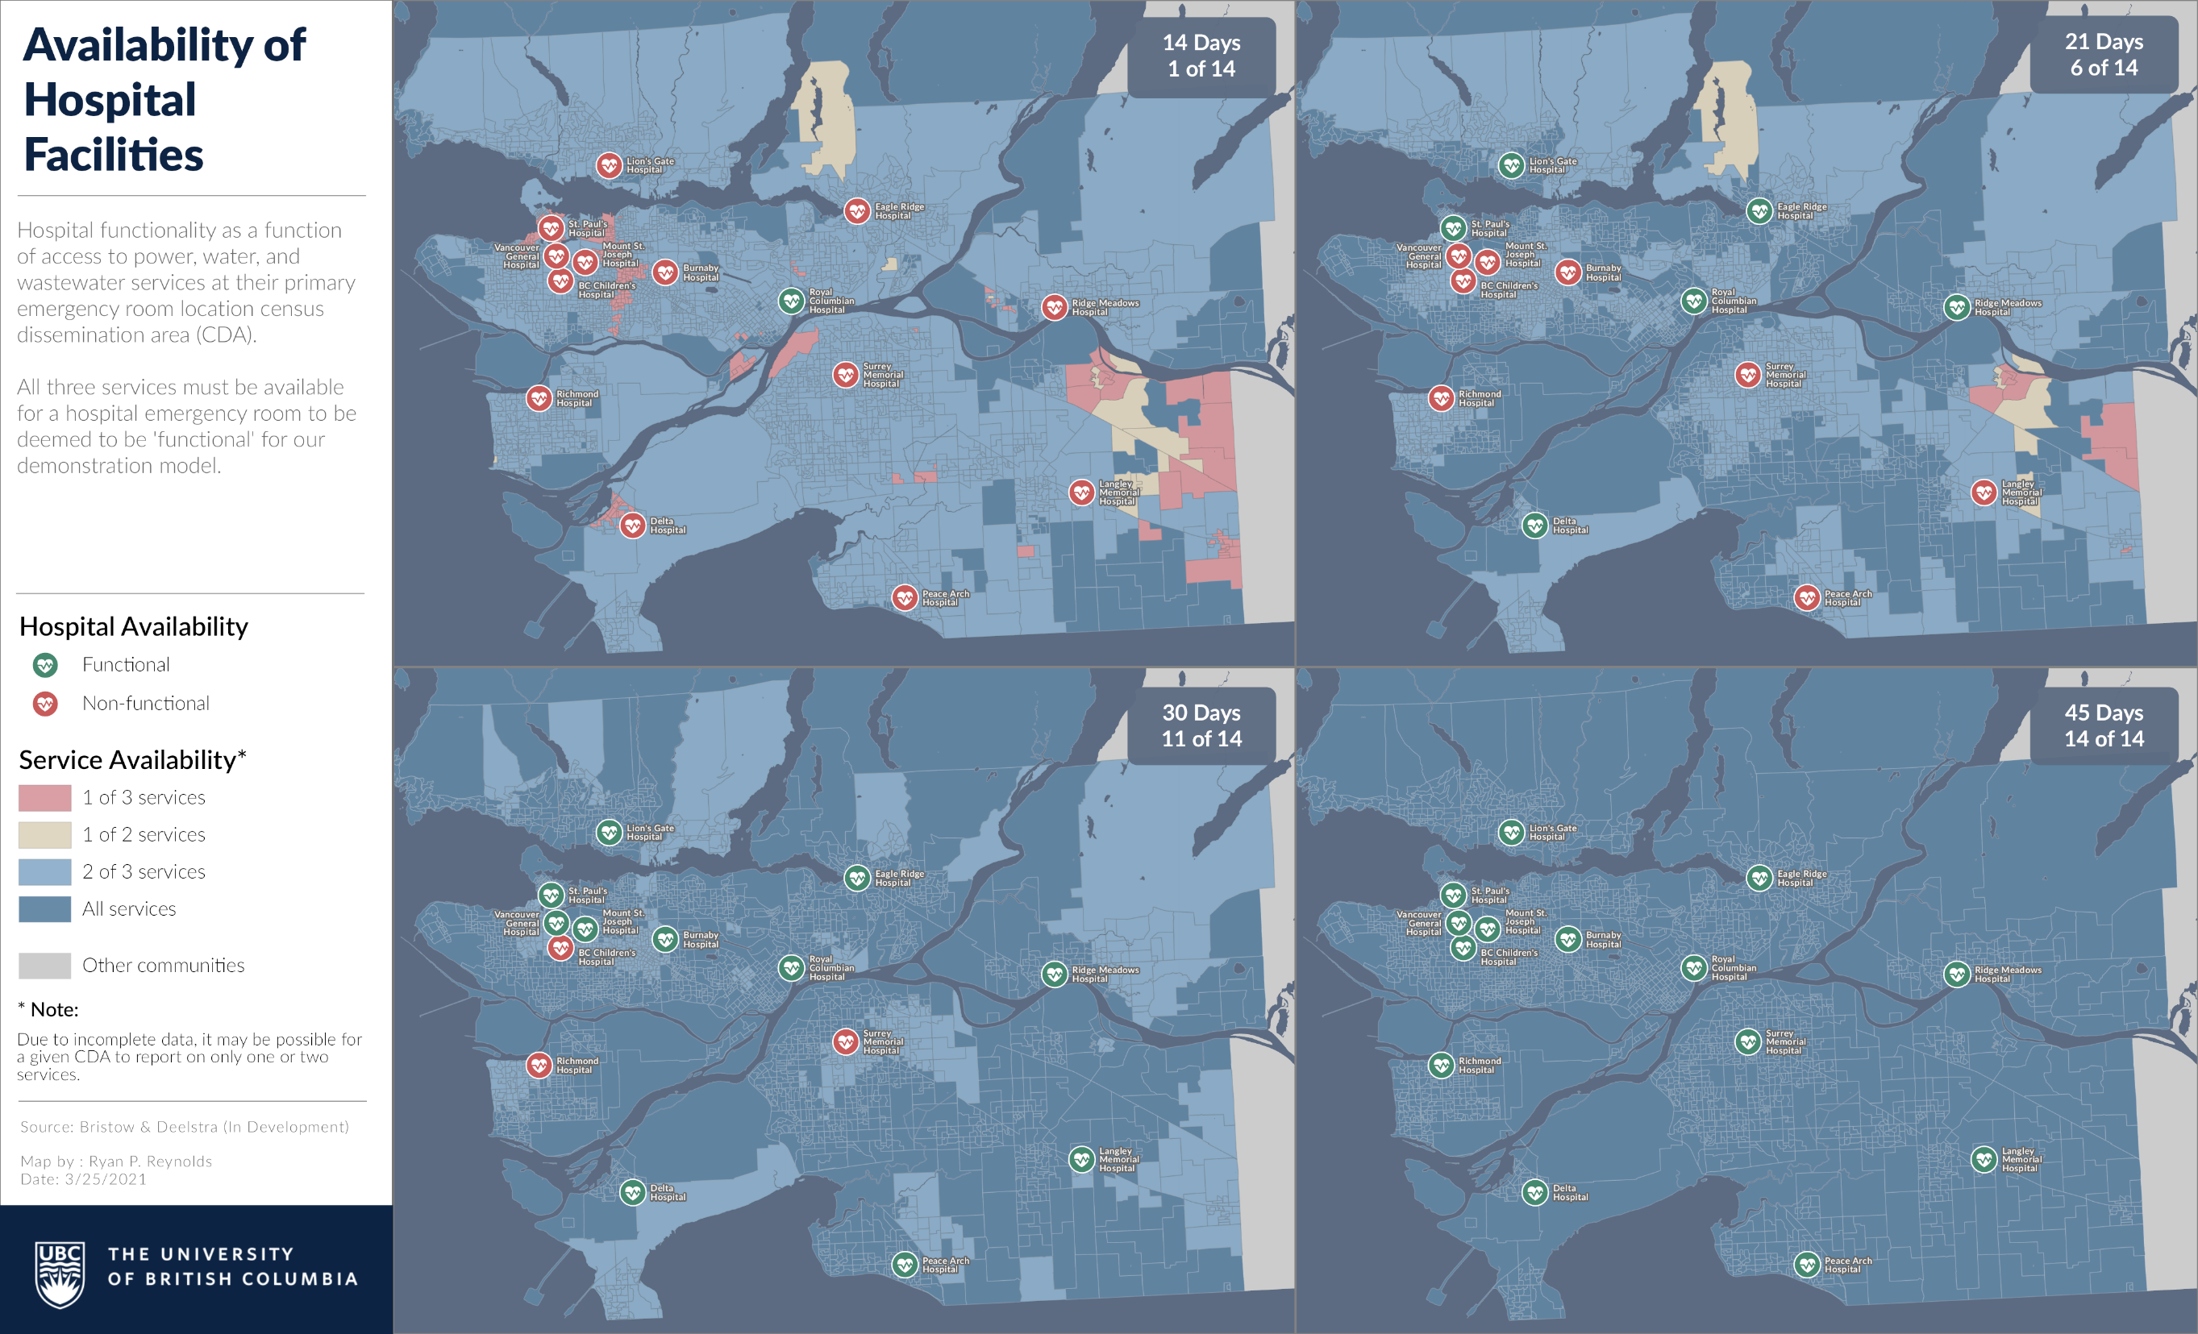
Notes:
Initially only the Royal Columbian Hospital in New Westminster is available.
By day 21, six facilities have come online in Maple Ridge, Delta, North Vancouver, and the City of Vancouver
By day 30, only three facilities remain offline in this scenario

Slide 11
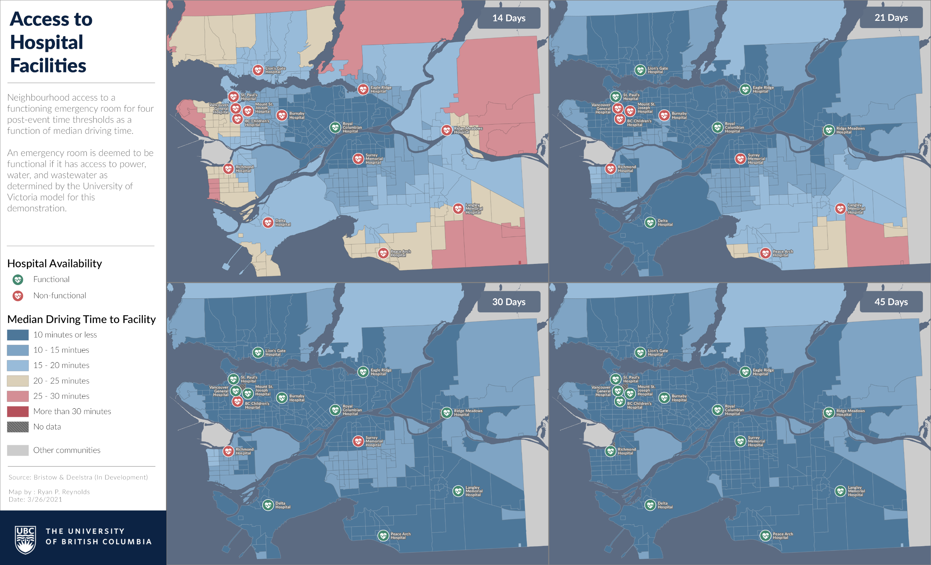
Notes:
With knowledge of which hospitals would be accessible, we conducted a network analysis to calculate the travel time to the nearest available hospital for each dissemination area

