Slide 1
Disaster Risk Reduction Pathways
Final Steering Committee Meeting – 25 June 2021

Slide 2
www.andyeverson.com
Notes:
I hope it’s ok, but as a federal scientist especially, I want to start by acknowledging the trauma inflicted by the residential school system, particularly in the wake of the discovery of so many unmarked remains at the sites of former residential schools. It is an immense and powerful tragedy, and I hope we can all make space during this time to heal, for those who have been harmed directly or intergenerationally, and to reckon with the institutionalized racism here in Canada and the role it has played in shaping our own privileges.
I also gratefully acknowledge that I have the opportunity to live and work on the unceded and ancestral territories of the Coast Salish Peoples, including the Musqueum, Slail-Waututh, and Squamish First Nations.

Slide 3
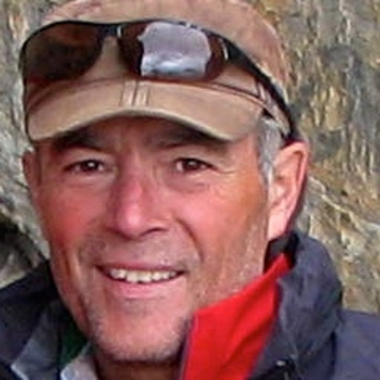
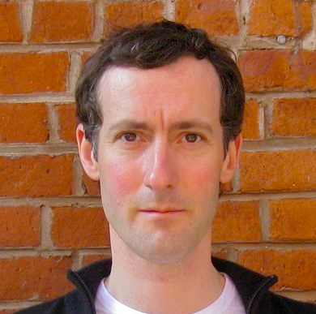
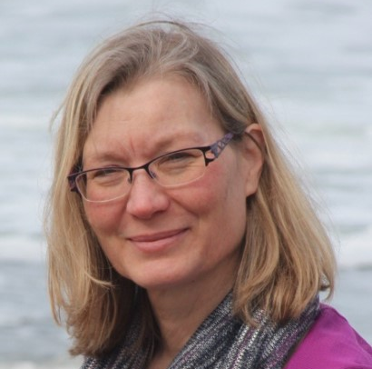
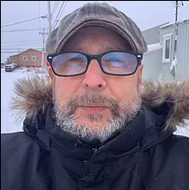
NRCan Seismic Risk
Murray Journeay
Tiegan Hobbs
Joost van Ulden
Drew Rotheram
Anthony Fok
Malaika Ulmi
Nicky Hastings
Jackie Yip
Philip LeSueur
Will Chow
Carol Wagner
Karolina Pol
Alison Bird
Mike Ellerbeck
NRCan Seismic Hazard: Michal Kolaj, Stephen Halchuk, John Adams, John Cassidy
GEM Hazard & Risk: Anirudh Rao, Vitor Silva, Marco Pagani, Kendra Johnson, Luís Martins, Michele Simionato, Paul Henshaw
Notes:
With that I’ll move onto the work we’ve been engaged in, by showing off some of the mostly smiling faces of our team here at NRCan who make any of this possible. When Sahar asked me to think about how things have improved since the beginning of DRR Pathways in Jan 2019, I think this slide alone might represent one of the biggest changes. Half of the people on this slide have come to NRCan in the last 2 years, myself included. It has brought so much capacity to the work that we’re doing, which will be highlighted by how many of us will be presenting today and Monday, to report on the numerous projects we’ve had the chance to undertake through DRRP and EMS.

Slide 4
Notes:
The one I’ll be talking about currently is our seismic risk modelling framework, which is the basis for the National Seismic Risk Profile for Canada, wherein we assess the impacts of earthquakes on Canadians and the buildings they inhabit. Pathways helped bridge the gap between the earthquake risk modelling work, to take us beyond damage to buildings.
2 branches, both report on physical and social
Produced using the OpenQuake Engine from GEM. This is another area to highlight that over the last 2 years, the Canadian model has continued to push the boundaries of what the OQ engine is capable of. Through the excellent work of our collaborators at GEM, we’ve seen huge improvements in the speed of computations, as well as augmented functionality. This includes the ability to perform stochastic damage calculations and the development of consequence functions, which allows for reporting on Sendai indicators through the probabilistic branch of our model.
We know that generally speaking, BC bears the largest burden of seismic risk in Canada due to our proximity to active tectonic plate boundaries, which has made the DRRP project so important as a testing ground for comprehensive and cross-disciplinary risk studies.

Slide 5
Seismic Risk
Risk
Exposure
Updated in 2020
Exposure
Fragility
Updated in 2021
Fragility
Hazard
Hazard
Site Response
Rupture
Ground Motion Prediction Equations
National
Seismic Hazard Map
Updated in 2020
Notes:
Our model uses the current best practices, globally, to estimate seismic risk at the national level
seismic risk is the product of the hazard (probability of shaking), exposure (who what in way), and fragility (measure of how likely exposed assets are to be impacted).
In our model hazard is described by rupture, or suite of sources, ground motion prediction equations relating shaking from source to site, and a measure of the site response
Exposure is a representative inventory of buildings and people in Canada, including construction material, primary load-bearing system, vintage, seismic design level, and occupancy type
Canadian-specific fragility and vulnerability curves relate the relevant spectral acceleration to the probability of damage or financial loss.
The NSHM is responsible for seismic sources and GMPE’s, and our work builds from there

Slide 6
Recent Updates
Big push to document the model, including exposure & multihazard risk
National Risk Model undergoing final adjustments
Minor changes to hazard model
Internal review of fragility / vulnerability functions
Feedback on retrofit simulations to align with engineering practice
External review of model
Scoping outputs / indicators
Sensitivity testing for updated National Seismic Hazard Model
Balancing computational demands with granularity of outputs
Public launch of Scenario Catalogue this month
Development of purpose-built web application: RiskProfiler

Slide 7
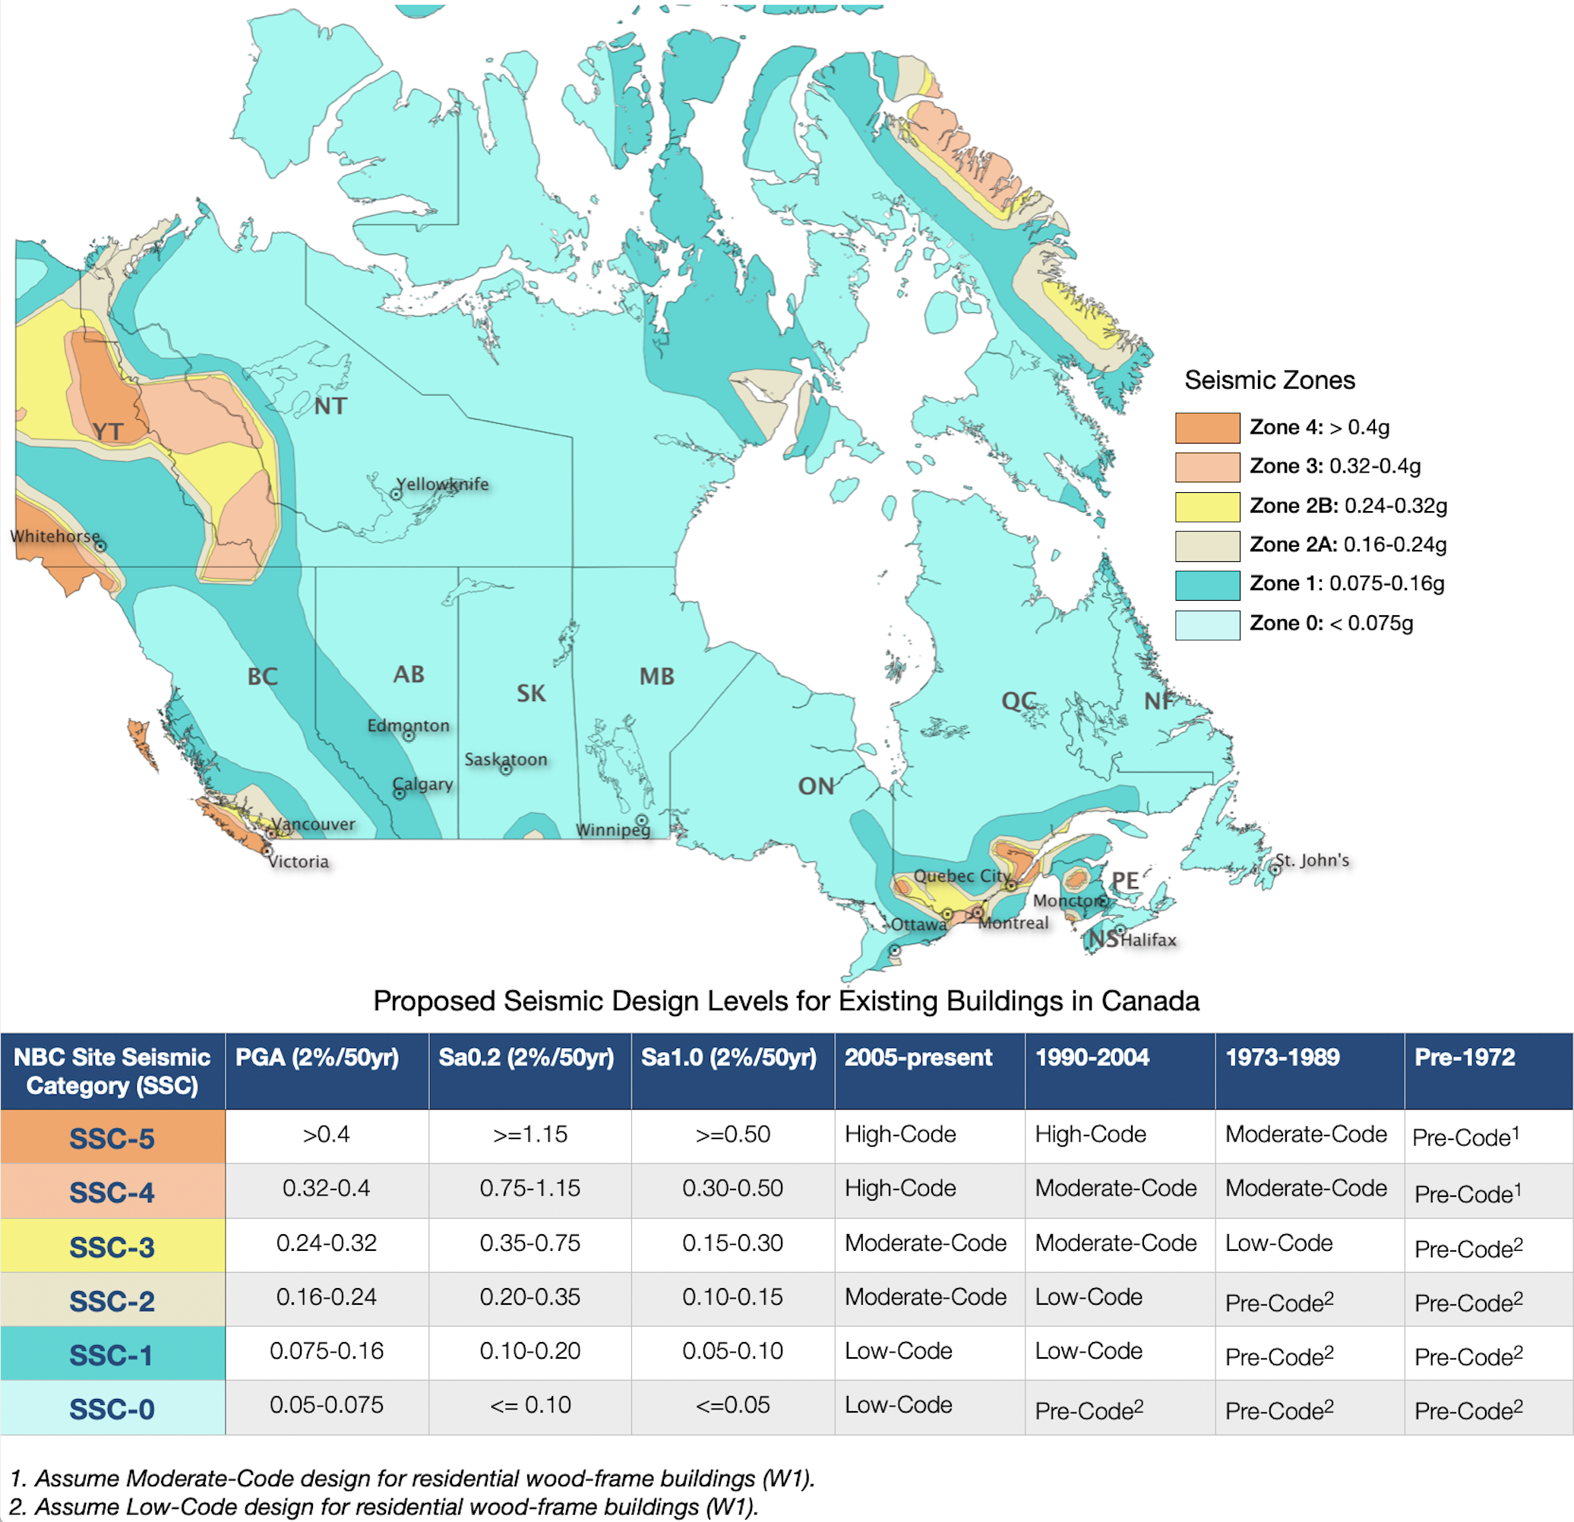
Buildings | Retrofitted Code Level
High Code | High Code
Unreinforced Masonry Elements | Low Code
Hospital/Emergency Response Facility | High Code
All Else | Mid Code
Notes:
In addition to modelling the risk with our current building stock, we also consider the potential impact of seismic retrofits. This year we undertook a process, with many of our DRRP partners, to ensure our retrofit simulation approach is in line with retrofits being performed by practicing engineers and decision makers. We polled

Slide 8
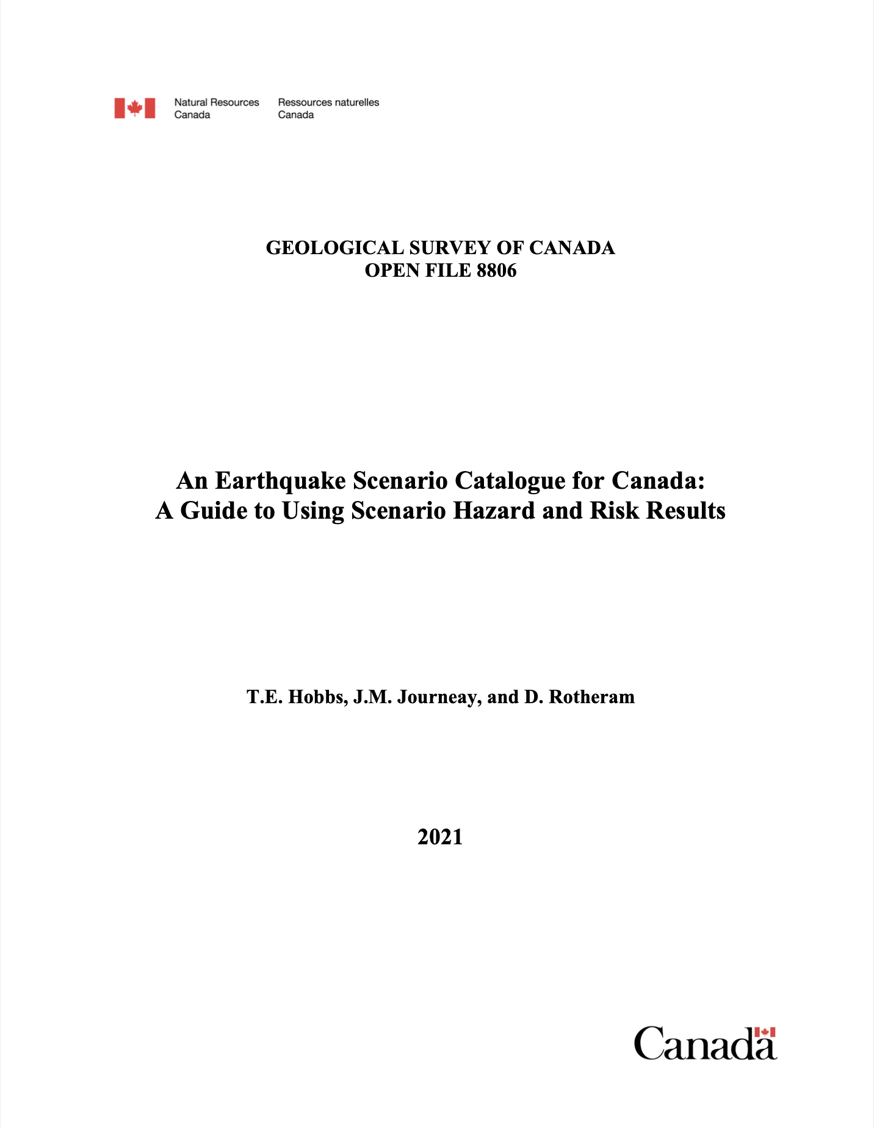
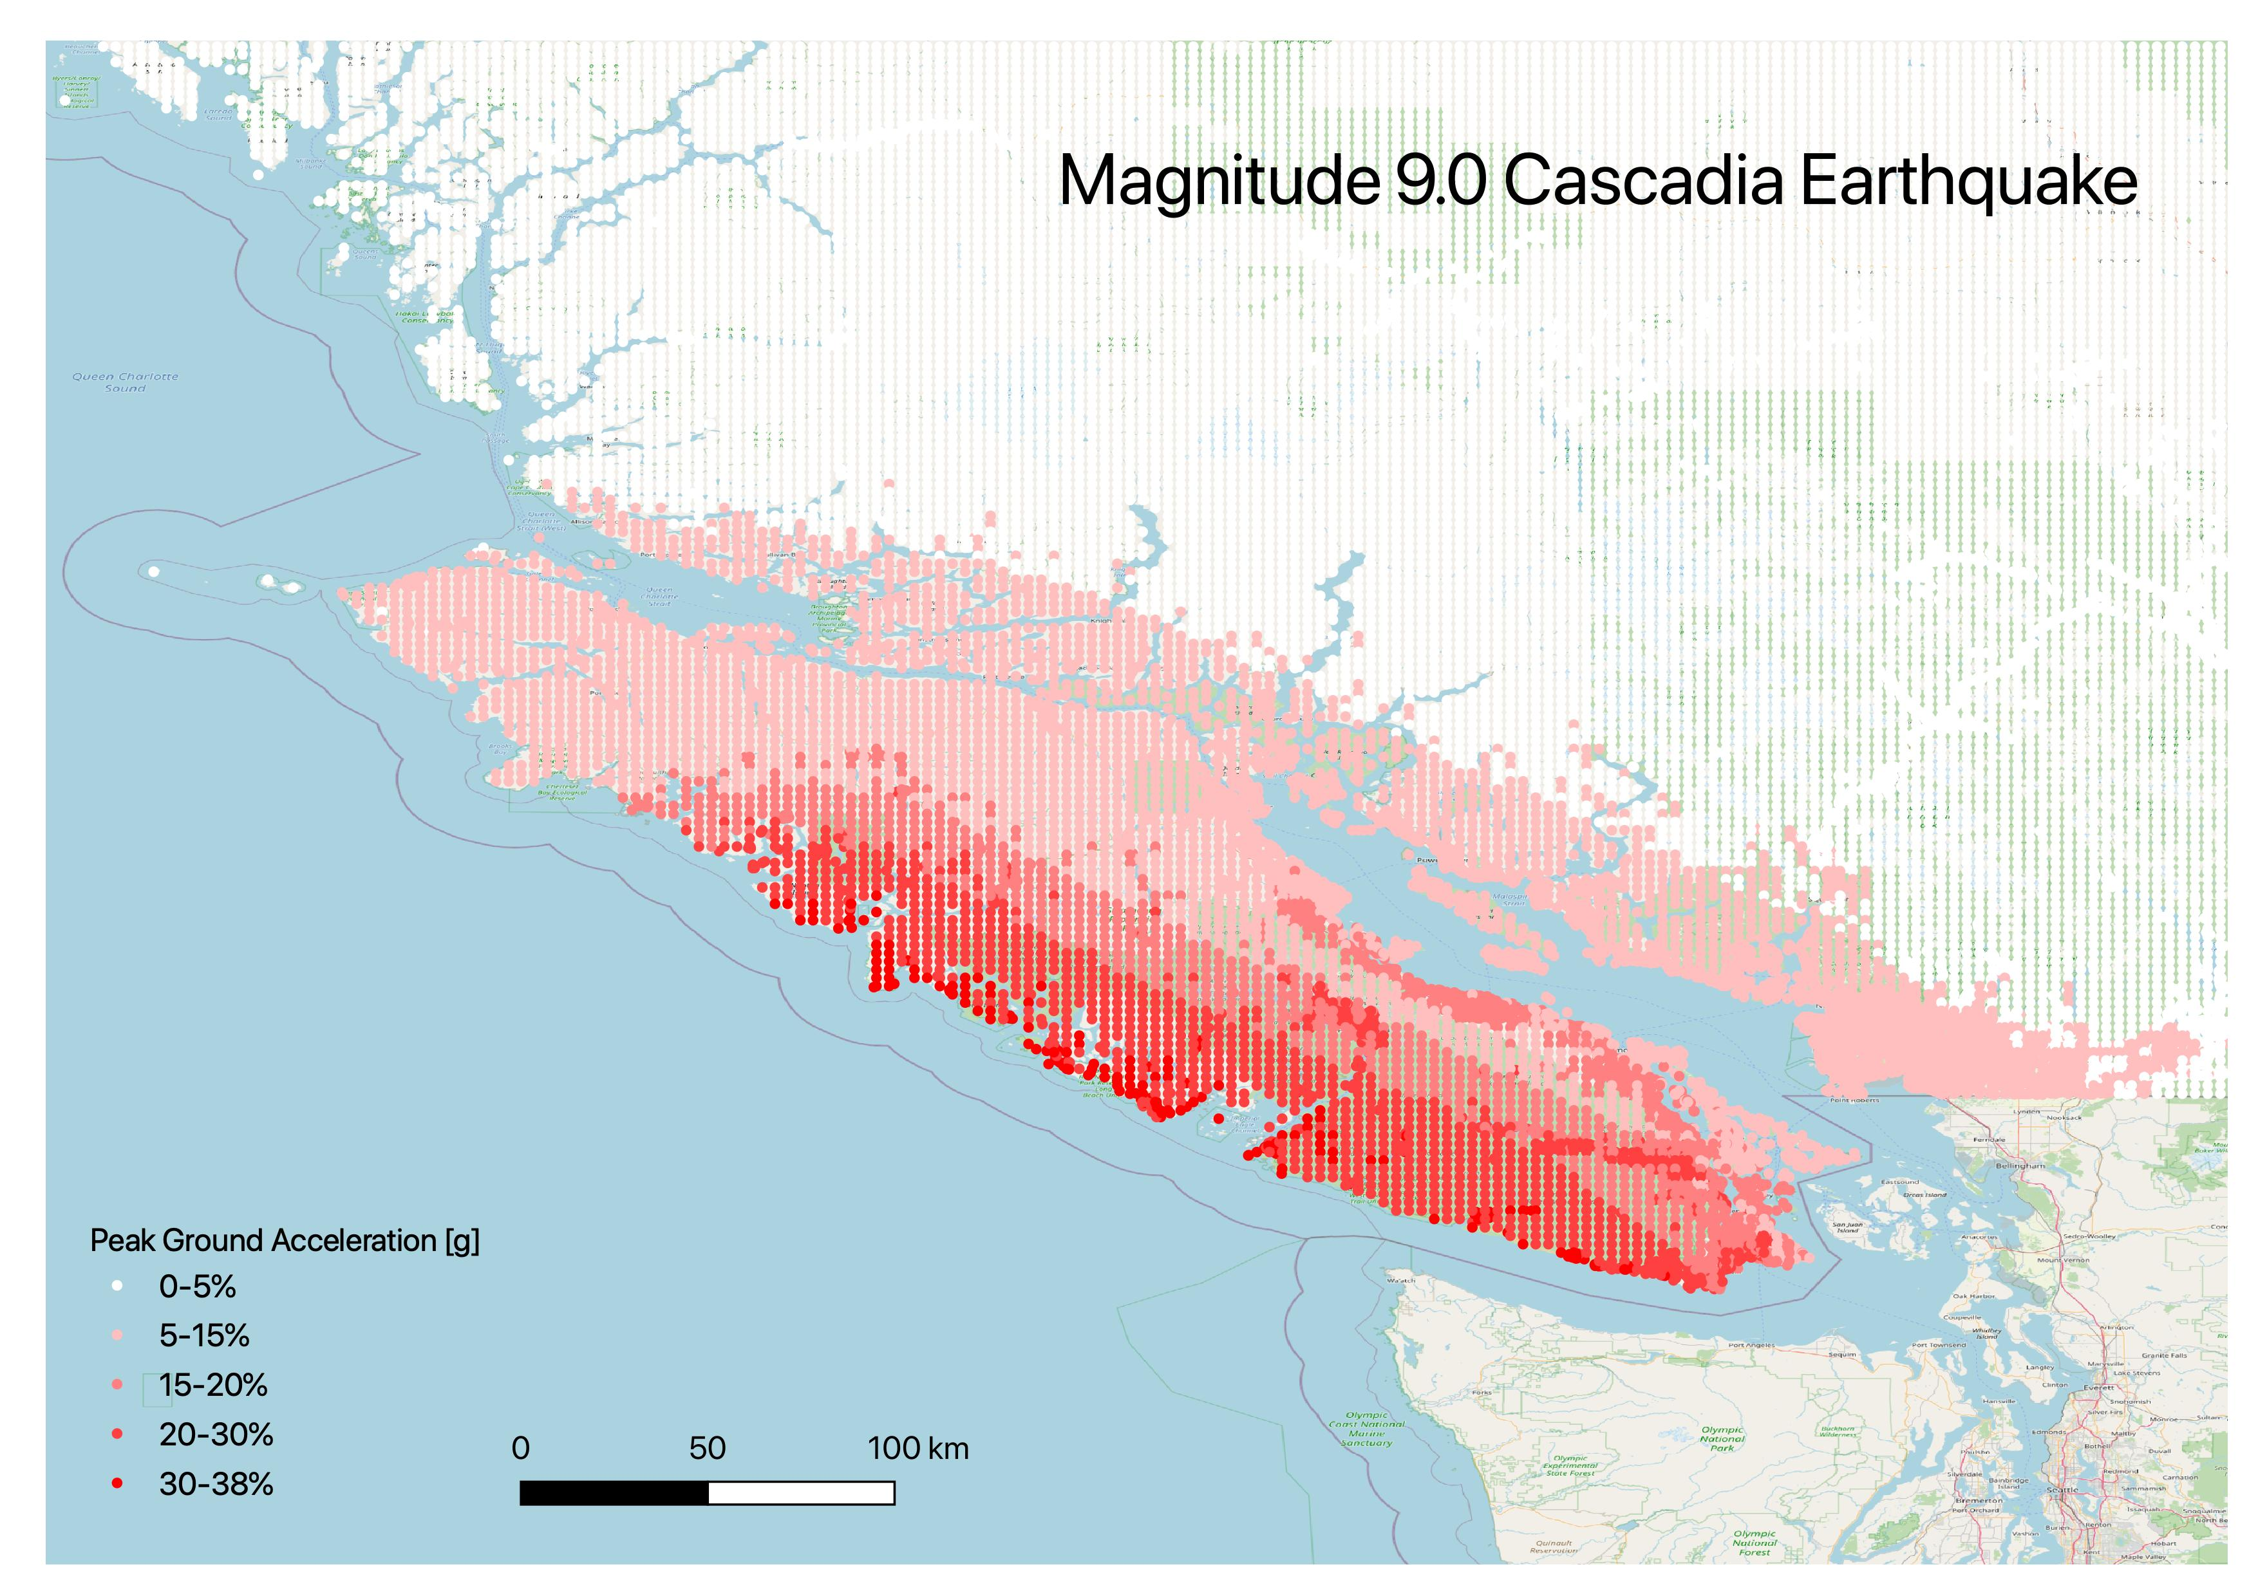
Scenario Catalogue
Consistent analysis methodology
Consistent set of outputs
Validation of model
Several presentations directly to practitioners
Ongoing work: fill out the catalogue
https://github.com/OpenDRR/earthquake-scenarios

Slide 9
Collaborations
Finance Canada
Aiding federal regulator to analyze protection gaps
Exercise Coastal Response 2022
Designing scenario for federal response exercise
Public Safety Canada’s All Hazards Risk Assessment
Designing scenarios for federal planning exercise
City of Vancouver
Municipal retrofit planning and site-level risk assessment
University of British Columbia
Developing Canada-specific fragility functions
McGill University
Contributing data for induced earthquake analyses in Northern BC

Slide 10
Resources
Searchable database of all NRCan geoscience knowledge, including reports and journal articles on earthquake hazard and risk: geoscan.nrcan.gc.ca/
Model development: Tiegan.Hobbs@Canada.ca
Platform development: Joost.vanUlden@Canada.ca
Exposure & Multihazard: Philip.LeSueur@Canada.ca
Science planning: Malaika.Ulmi@Canada.ca
Global Earthquake Model: www.globalquakemodel.org
Habitat Seven: www.habitatseven.com

Slide 11
© Her Majesty the Queen in Right of Canada, as represented by the Minister of Natural Resources, 2019

