Slide 1
A Functional Approach to Critical Infrastructure and Community Resilience Presentation for DRR Pathways Steering Committee Meeting 25 & 28 June 2021
Notes:
)

Slide 2
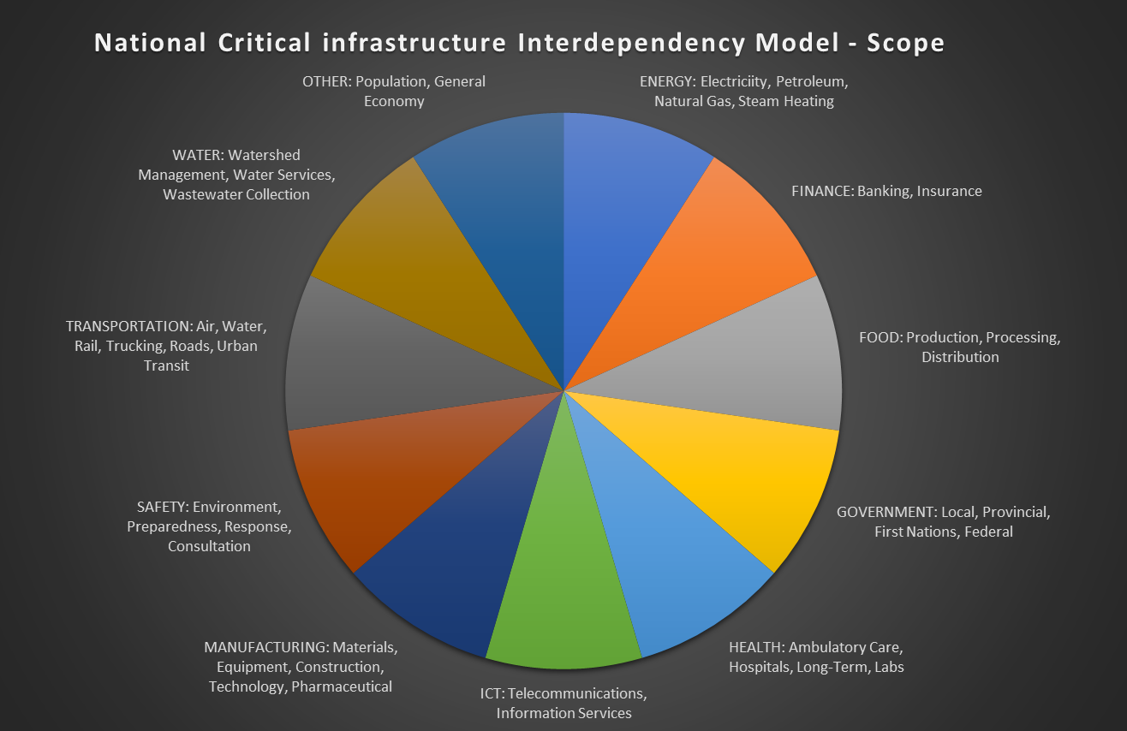
National Critical Infrastructure Interdependency Model
The National CI Model consists of 819 functions for 52 sub-sectors across the 10 sectors in the National CI Strategy plus an ‘Other’ sector for the population and general economy
In addition to the functions the NCIM includes directed links among the functions showing potential dependencies (the model has over 5,000 dependency relationships)
When ‘informed’ by the specifics of a scenario, the set of functions and relationships can be analyzed by a variety of network analysis tools to understand how risk ‘propagates’ in network

Slide 3
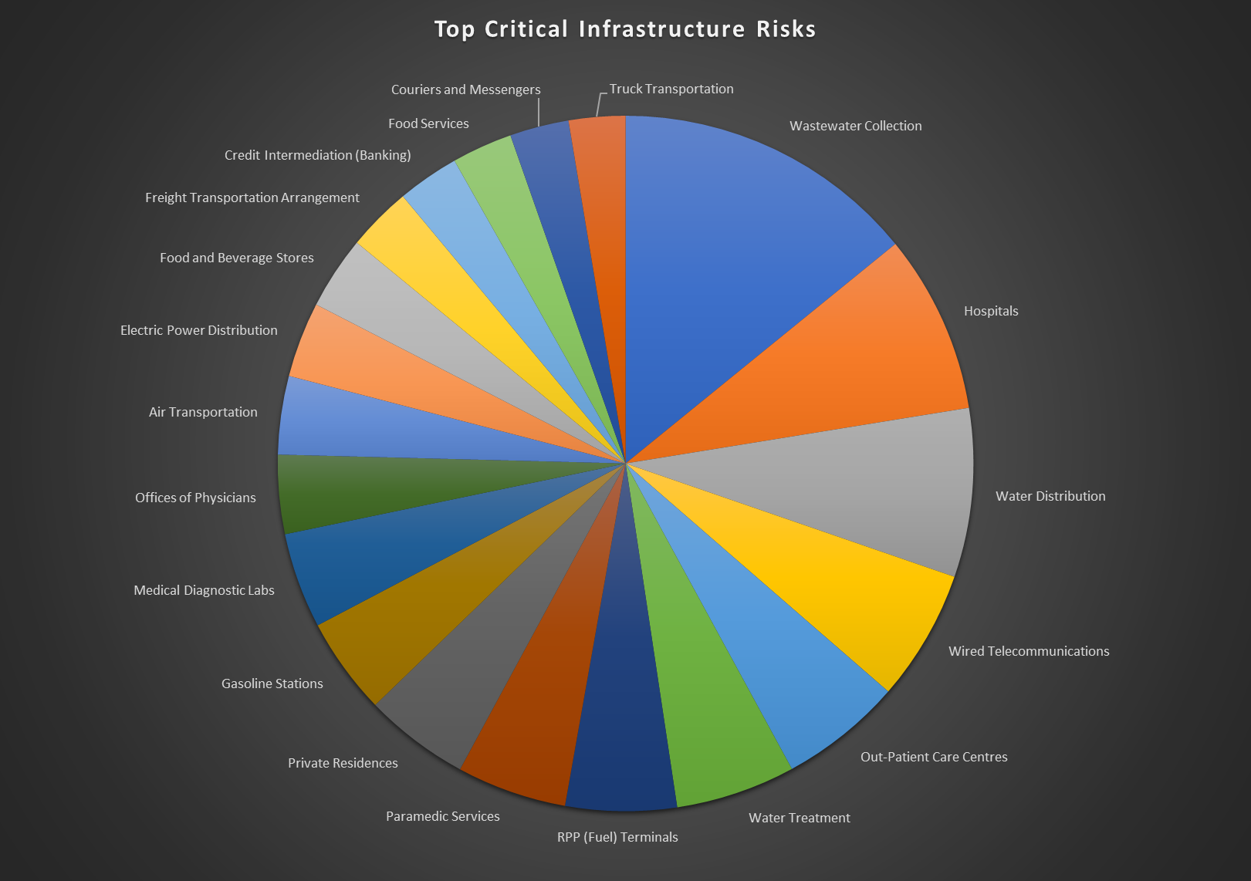
Top Functions at Risk in the DRR Scenario
Significant risk in the DRR Pathways earthquake scenario associated with the disruption of hospitals

Slide 4
Hospitals – Seismic Damage to Buildings
Open Quake Results for Hospital Buildings
Days to Recover are the Open Quake results for:
Min = recovery time for the hospital building with the best recovery time
Mean = recovery time averaged over all hospital buildings
Max = recovery time for the hospital building with the worst recovery time
NRCan analysis with Open Quake provides estimates of structure or building recovery time, which includes repair time, due to seismic damage. It does not include the effect of disruption on critical services upon which hospital depend
U of Victoria analysis (with GMOR) provides estimates of utility recovery times for electricity, water and wastewater services
NCIM integrates these estimates with other dependencies, such as labour force availability
Starting point for NCIM network analysis

Slide 5
Hospitals – Recovery of Buildings and Utilities
Table shows the results of combining recovery time from earthquake damage and restoration time for critical utility services
Power (electricity), Water and Wastewater are from U of Victoria GMOR analysis; Facility recovery time is from NCan Open Quake analysis
Mitigation is not shown (e.g., backup power generation)
Hospital in bold font have emergency care services

Slide 6
Hospital – Vulnerability and Recovery Profile
Vulnerability = Degree of Dependency X Likelihood of Exposure to the Disruption of the Specified Service

Slide 7
Questions
7

