Slide 1
Community Archetypes of Social Vulnerability

Slide 2
GOAL
Understand how the specific and nuanced types of social vulnerability in a community can be characterized and used to support bottom up risk reduction efforts from practitioners and community authorities
Open File in preparation, for release later this year
Notes:
The vulnerability of people to natural hazards varies from place to place depending on characteristics of physical setting, social fabric and broad scale socio-political influences that have shaped regional patterns of human settlement over time.
Social vulnerability assessment addresses the question of who is most likely to be affected by the immediate impacts of a hazard event, and the underlying human and socioeconomic factors that may amplify the negative downstream consequences during both response and recovery phases of a disaster. This study addresses the complex set of social interactions that influence characteristics of social vulnerability and the determinants of risk at a neighborhood scale. In other words, ..

Slide 3
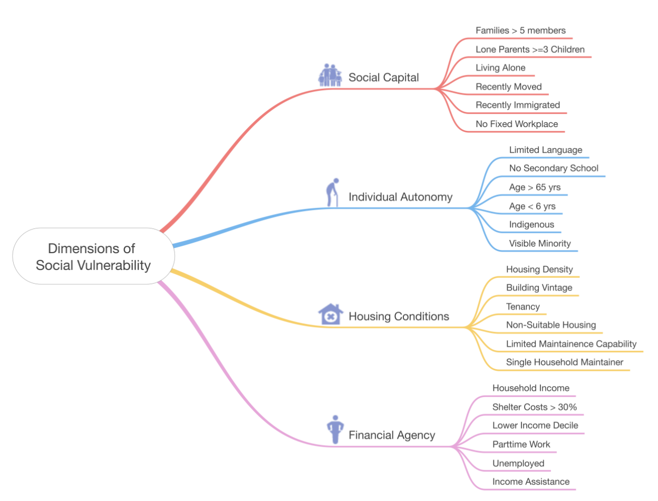
Notes:
We know that social vulnerability is complex, and difficult to measure in a way that allows for meaningful change or comparison across jurisdictions. Variables of social vulnerability were selected to be relevant at the scale of municipal-level planning and accessible using demographic data reported by Statistics Canada at the dissemination area level. Values were normalized, and a principle component analysis was performed to account for covariance correlation between variables.
Social Capital reflects characteristics of household size, family characteristics, mobility and regular workplace relationships that are relevant for assessing capacities to anticipate and withstand the immediate impacts of a hazard event. Individual Autonomy encompasses characteristics of age, literacy, language barriers and socio-political capital that can influence capacities to withstand, evacuate from and respond to the impacts of a hazard event. Housing Conditions reflect the dimensions of ownership, population density, suitability of accommodation and relative capacities for maintenance and upkeep of physical assets. Financial Agency reflects the relative capacities of individuals and groups to take actions on their own behalf following a disaster event to arrange for safe shelter, emergency supplies and to repair/replace capital assets that may have been damaged as a result.

Slide 4
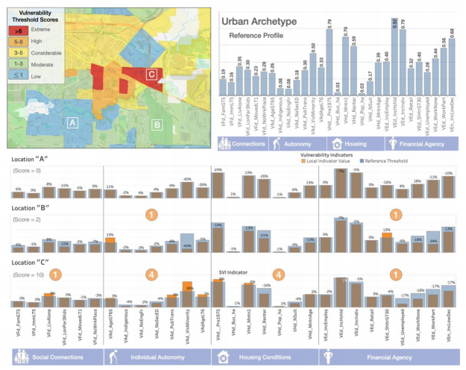
Notes:
From these indicators, one can find the average value or achetype, and consider how smaller regions compare. In each neighborhood, a score of +1 would be assigned if a variable exceeds the average plus one standard deviation. This allows us to identify communities which face more than the average burden, as determined by that variable. This is currently underway, I believe, across Canada, to help us understand how the social fabric may be strained by hazard events in the future.

Slide 5
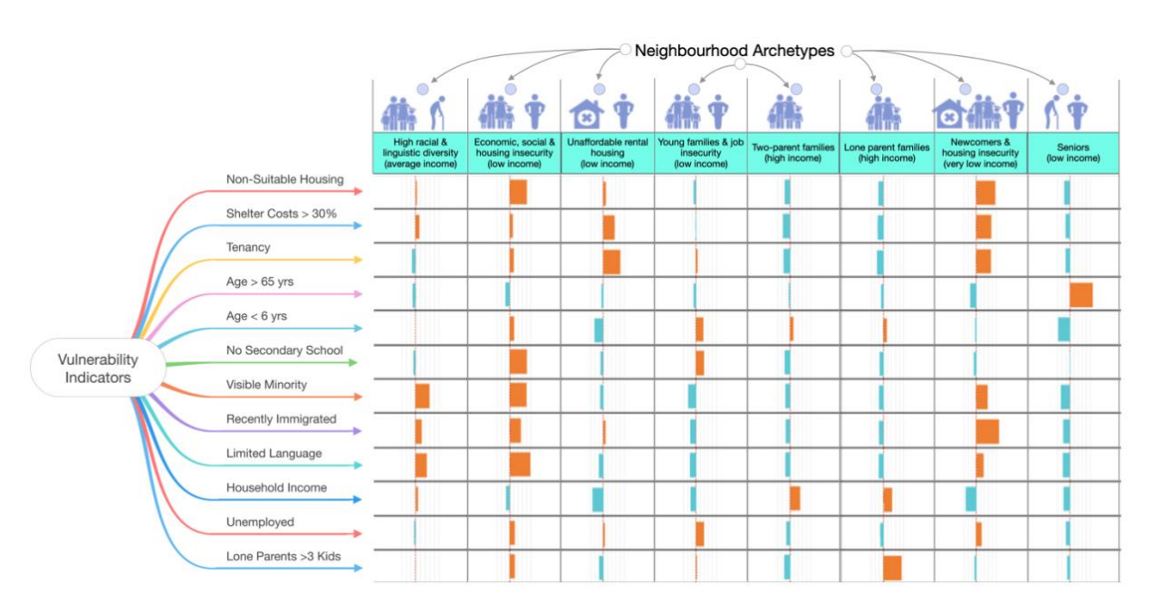
Notes:
Here in BC, though, we’ve been able to go even further. While vulnerability thresholds offer a methodology to evaluate and compare relative levels of social vulnerability from one region to another, the assessment of neighborhood typologies provides a more focused analysis of the underlying drivers of vulnerability from the perspective of those most affected. This is a subtle but important shift in perspective that re-frames the analysis on causal factors attributed to specific combinations of demographic variables that can be characterized through the lens of neighbourhood archetypes.
A pilot study was carried out for the province of British Columbia, assessing neighborhood-level vulnerability archetypes using machine learning and related pattern recognition techniques to detect and characterize relationships between distinct population groups and corresponding patterns of social vulnerability. Eight distinct neighborhood archetypes are defined based on a subset of vulnerability measures from the national model. Each dissemination area in the province of British Columbia is then assigned to one of the eight characteristic neighborhood archetypes based on a quantitative measure of similarity.
Re-framing the context of analysis in this way has the potential to bridge top-down quantitative methods of assessing levels of social vulnerability with bottom-up approaches that reflect local knowledge and understanding of the many ways in which a particular community can be vulnerable to natural hazards and underlying causal factors. This is particularly relevant for prioritizing planning and policy development efforts around those neighborhood archetypes that are likely to bear the greatest burden of risk, and the specific capacities and/or additional services they may need to enhance disaster resilience and related prospects of functional recovery.

Slide 6
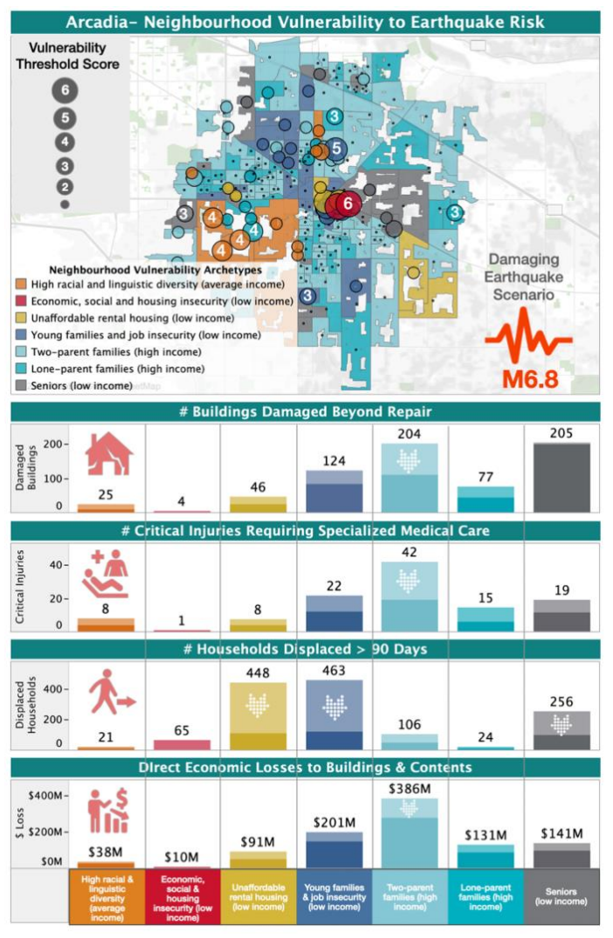
Results were featured in a URBC session
Community archetypes meant to aid place-based community level preparedness and mitigation
This work to be published later this year
Notes:
As part of Pathways, Murray, Jackie, et al., bridged these neighborhood archetypes with the results of the M6.8 scenario earthquake, and held a URBC session to allow practitioners to interact with these datasets simultaneously. This demonstrated, for a fictional city, the preponderance of certain types of neighborhood groupings which would be likely to suffer disproportionately – in this case young families with low income and those with low income who had tenuous housing. It also allows us to identify opportunities to reduce risk for those groups in particular through retrofits which could make a drastic difference in terms of the number of people experiencing displacement.

